Slide 1
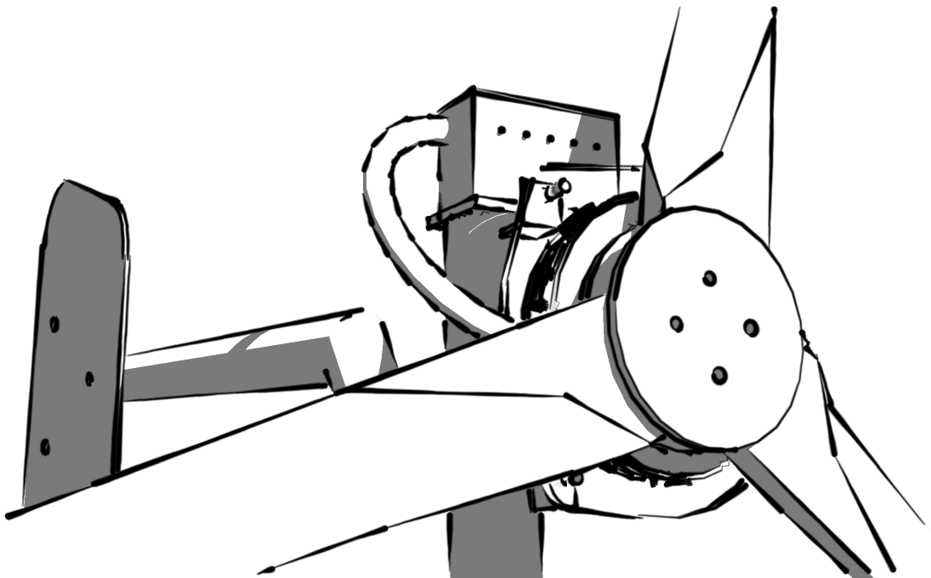
Wind Turbine Workshop V3 Power

Slide 2
Electrical system

Slide 3
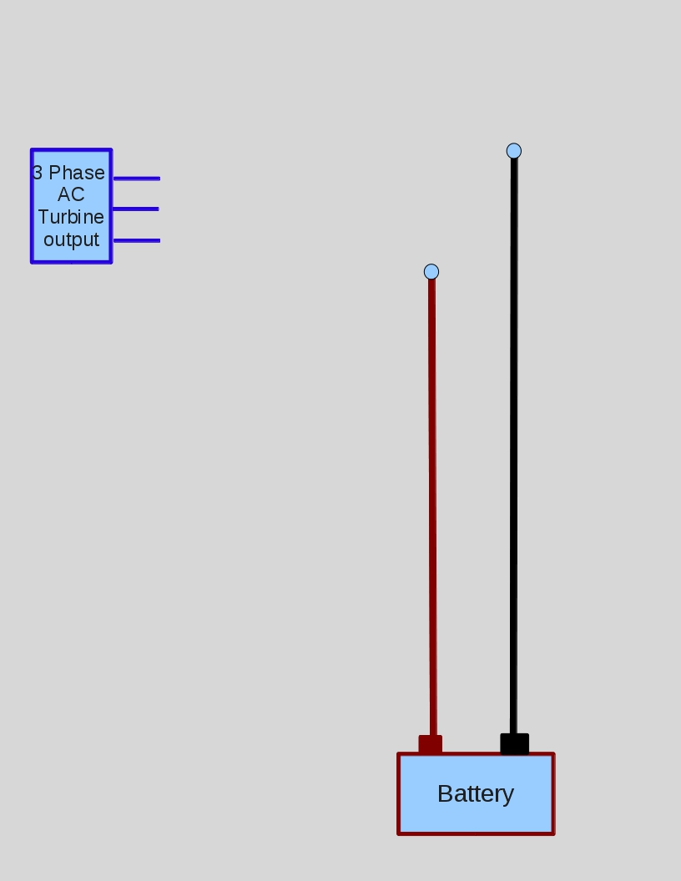
Alternators

Slide 4
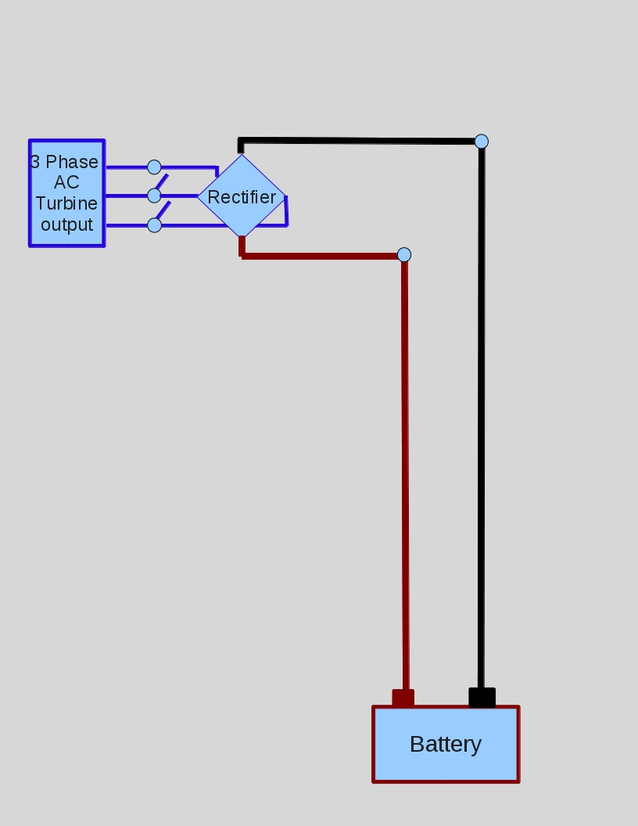
Alternators

Slide 5
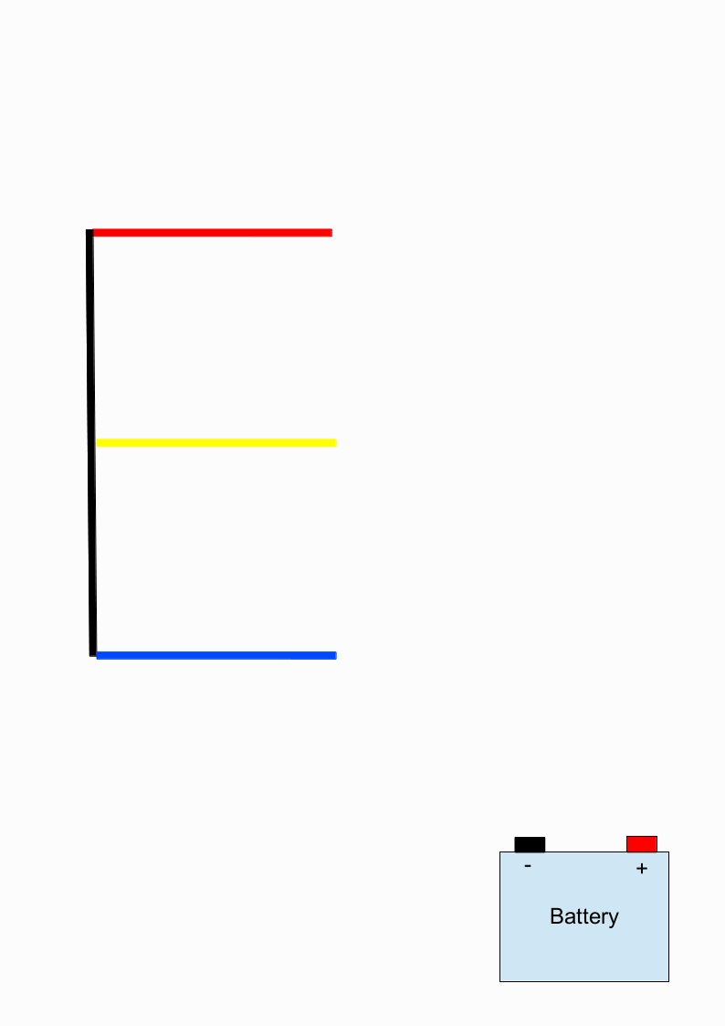

Slide 6
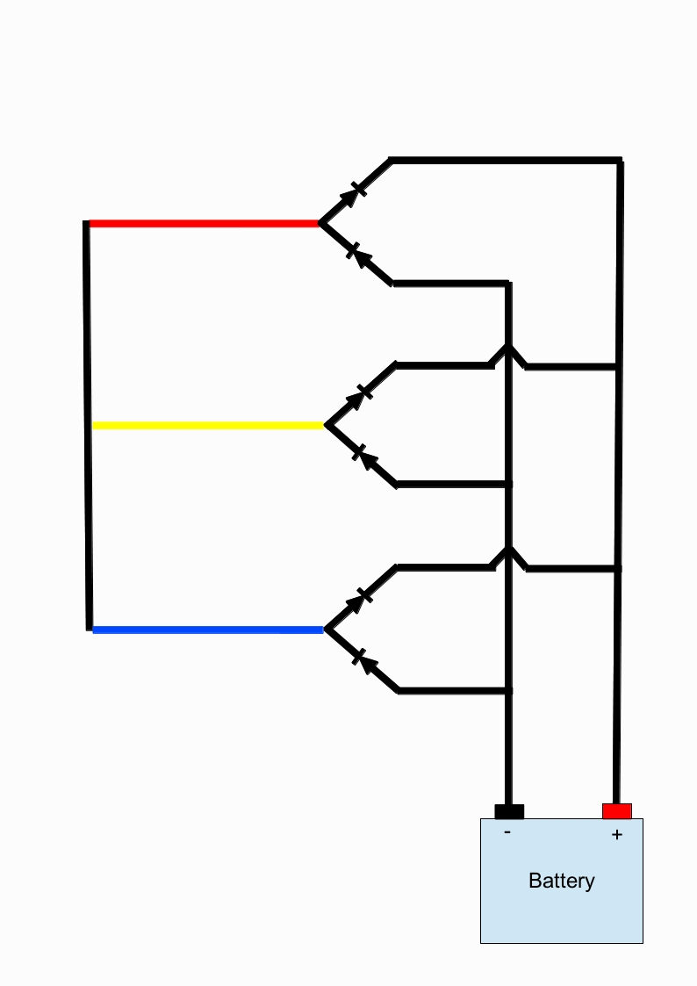

Slide 7
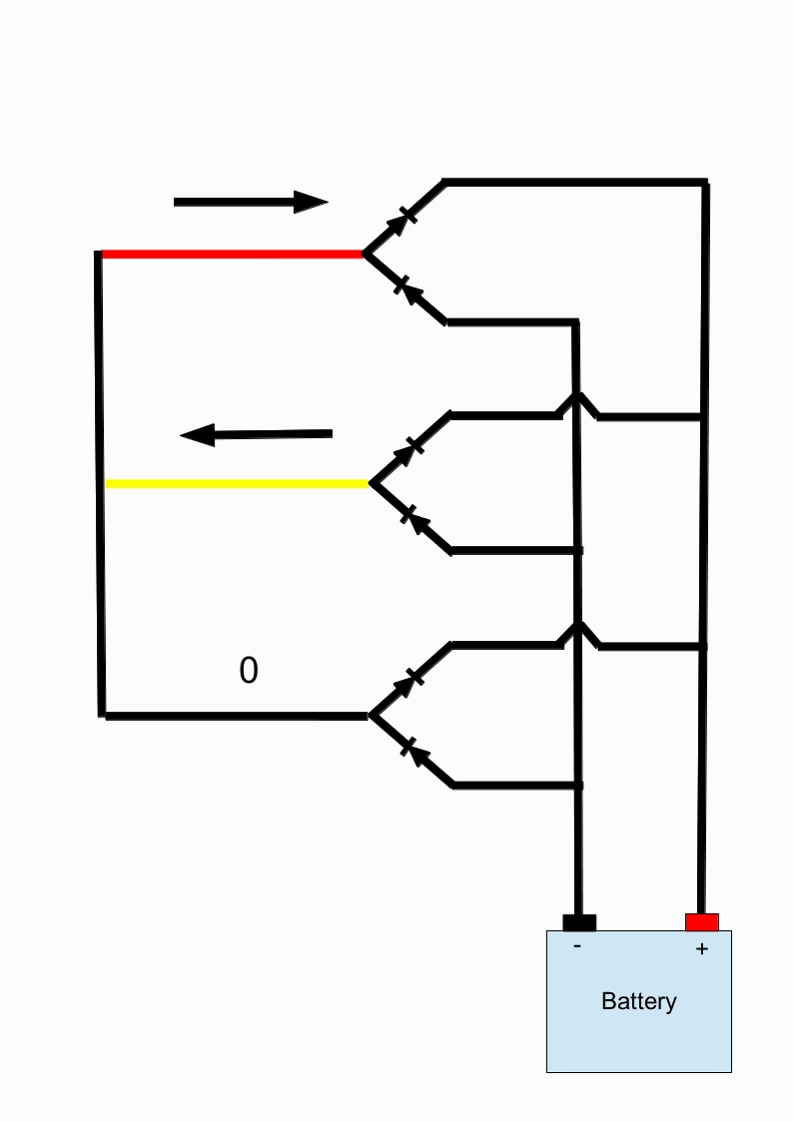
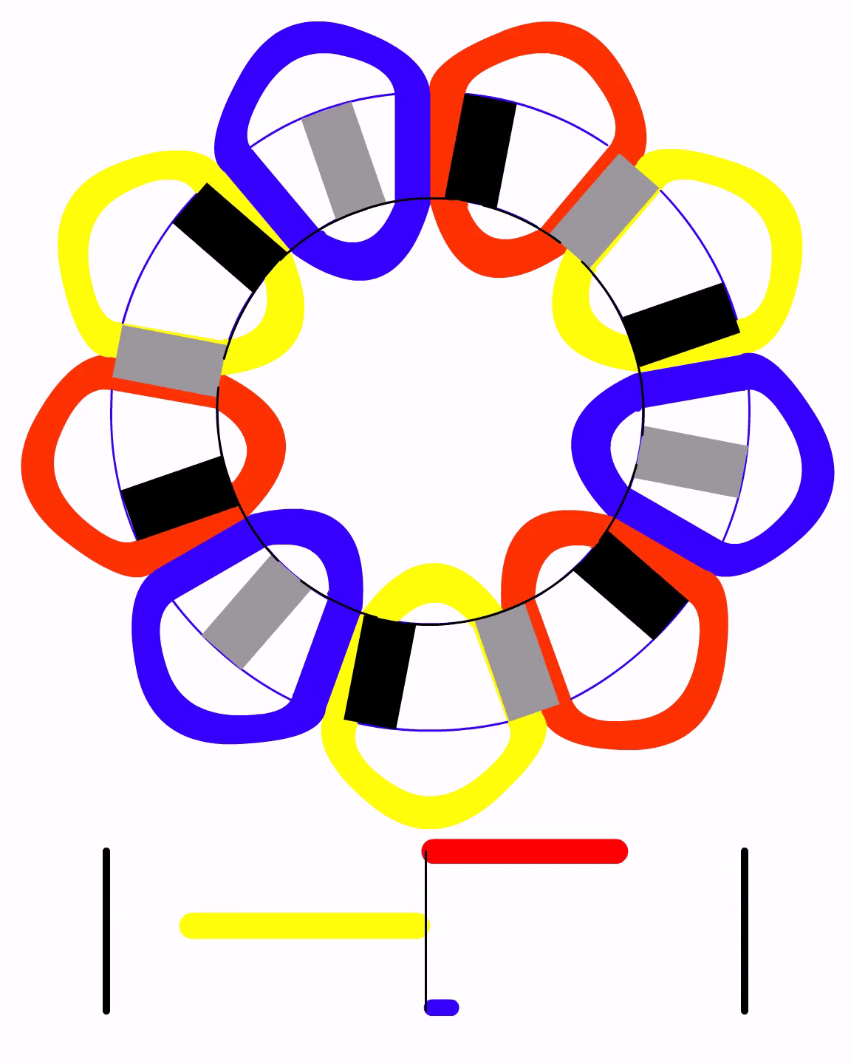

Slide 8
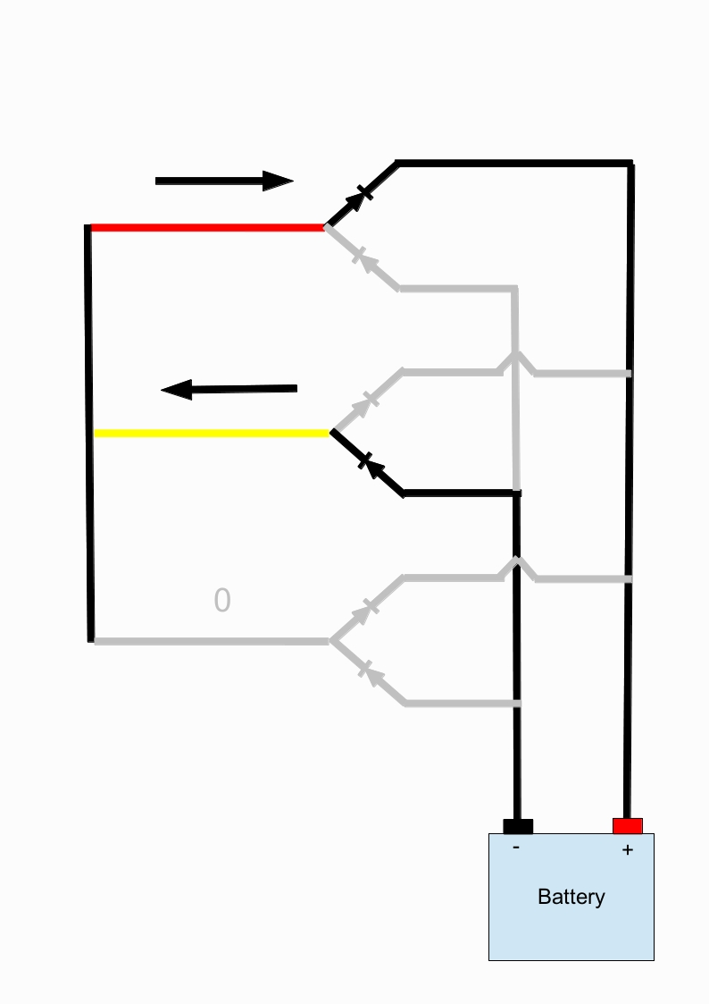

Slide 9
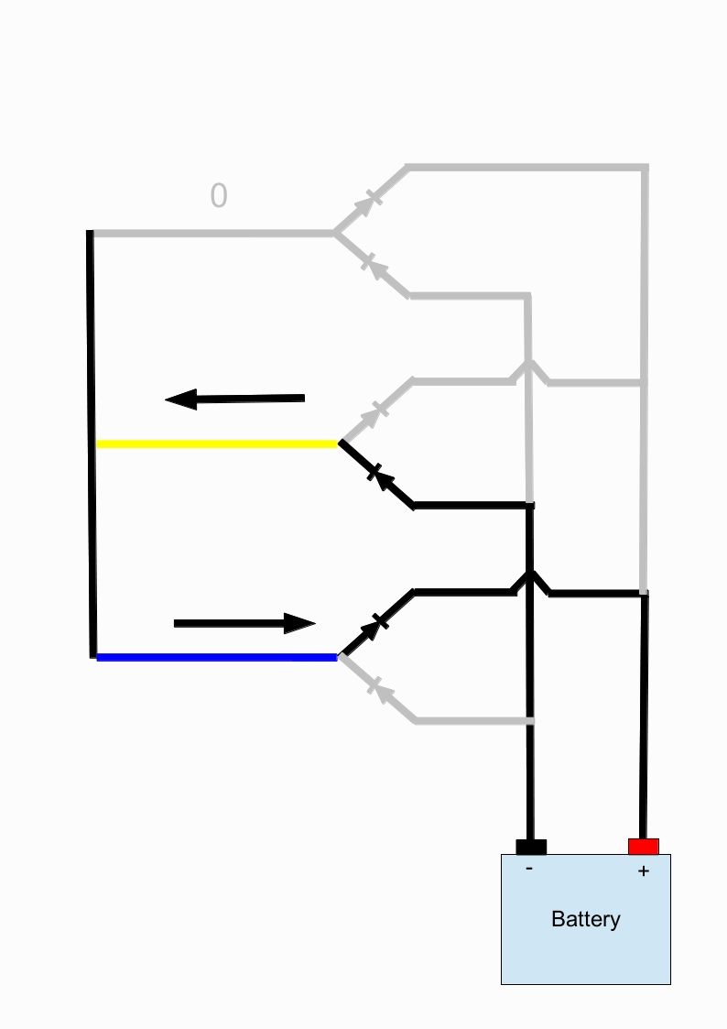
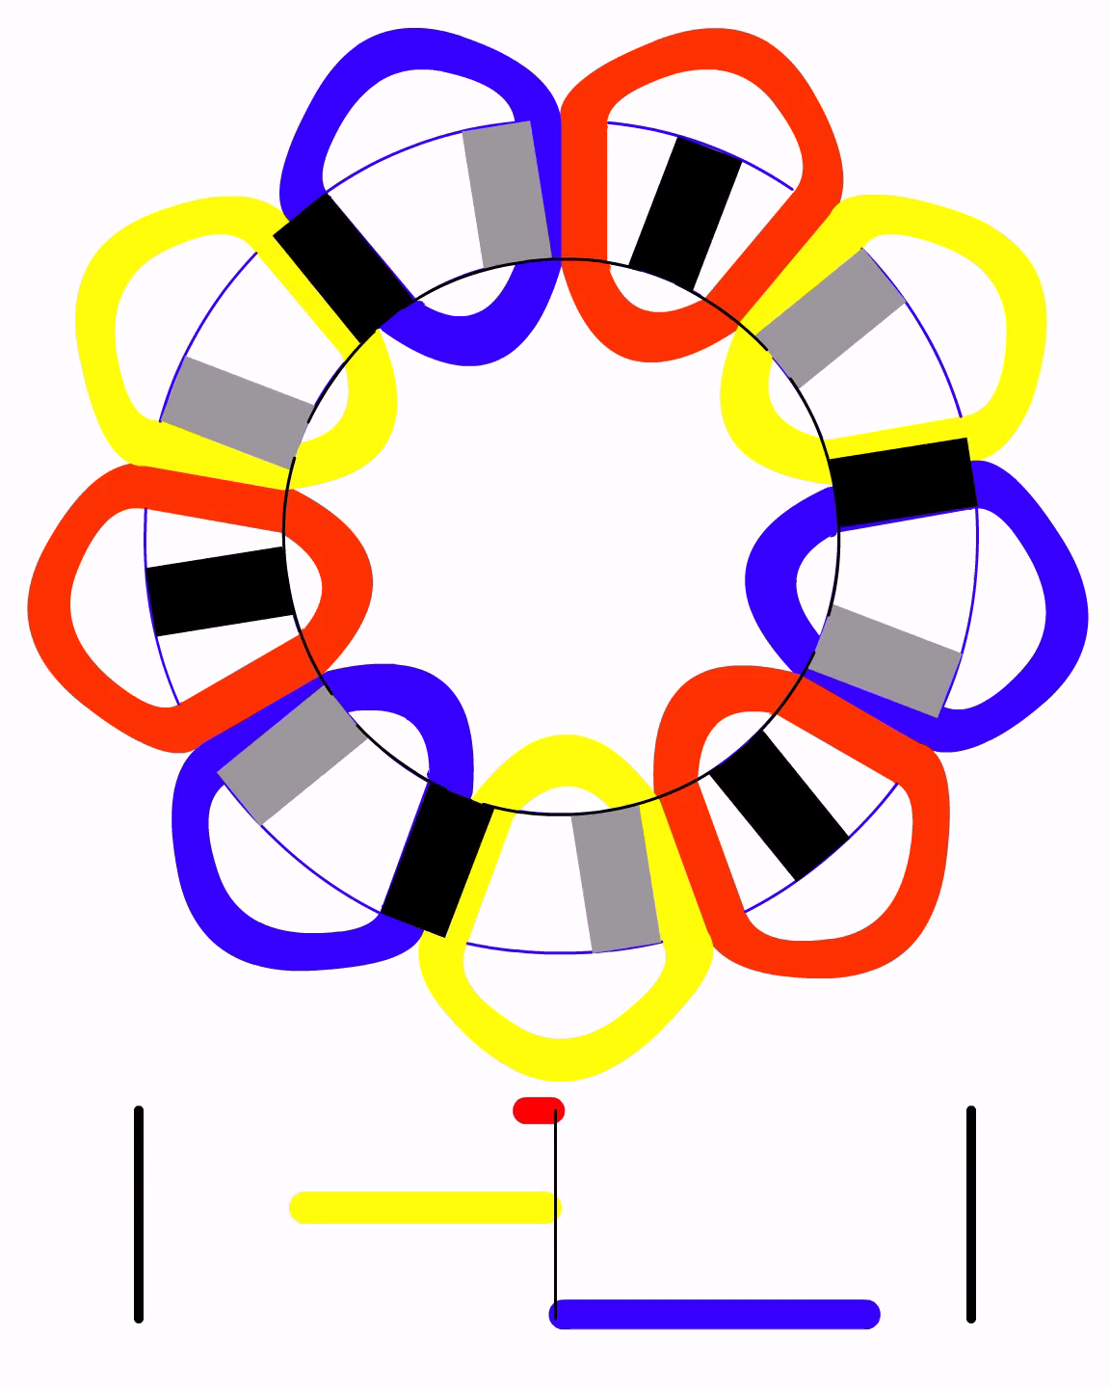

Slide 10
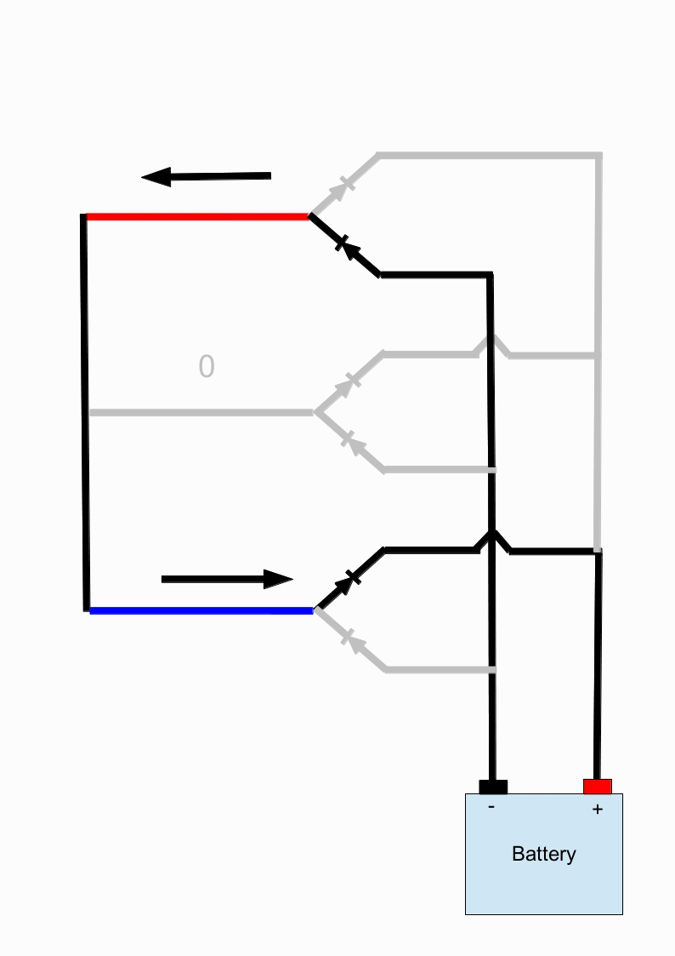
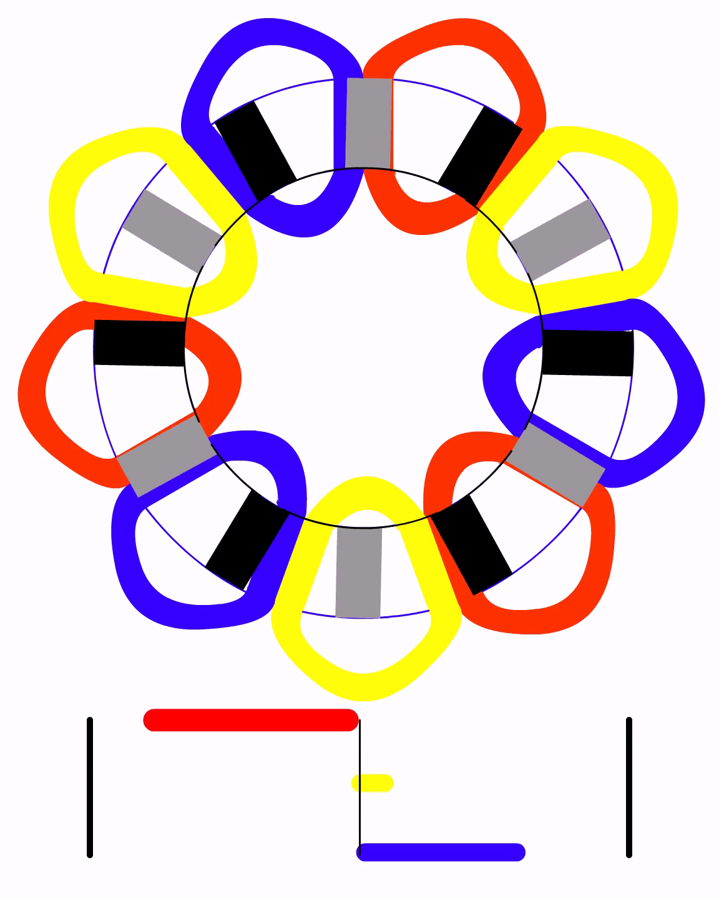

Slide 11
Alternators

Slide 12
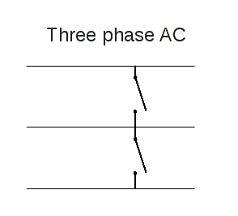
Braking the Turbine
Two options – AC or DC
Ensure they are rated for current @ AC/DC

Slide 13
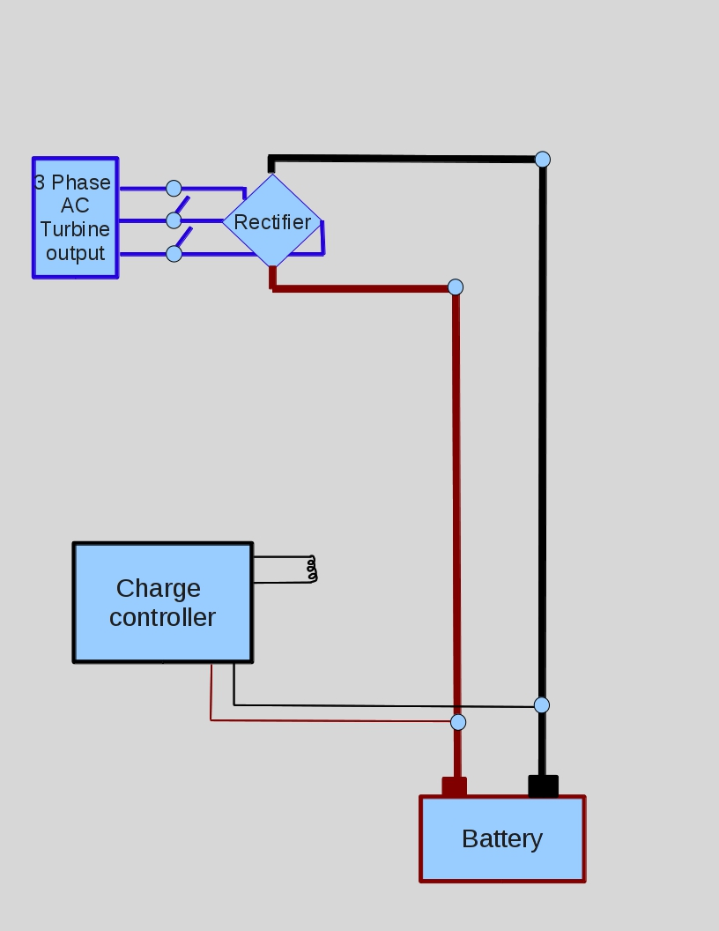
Alternators

Slide 14
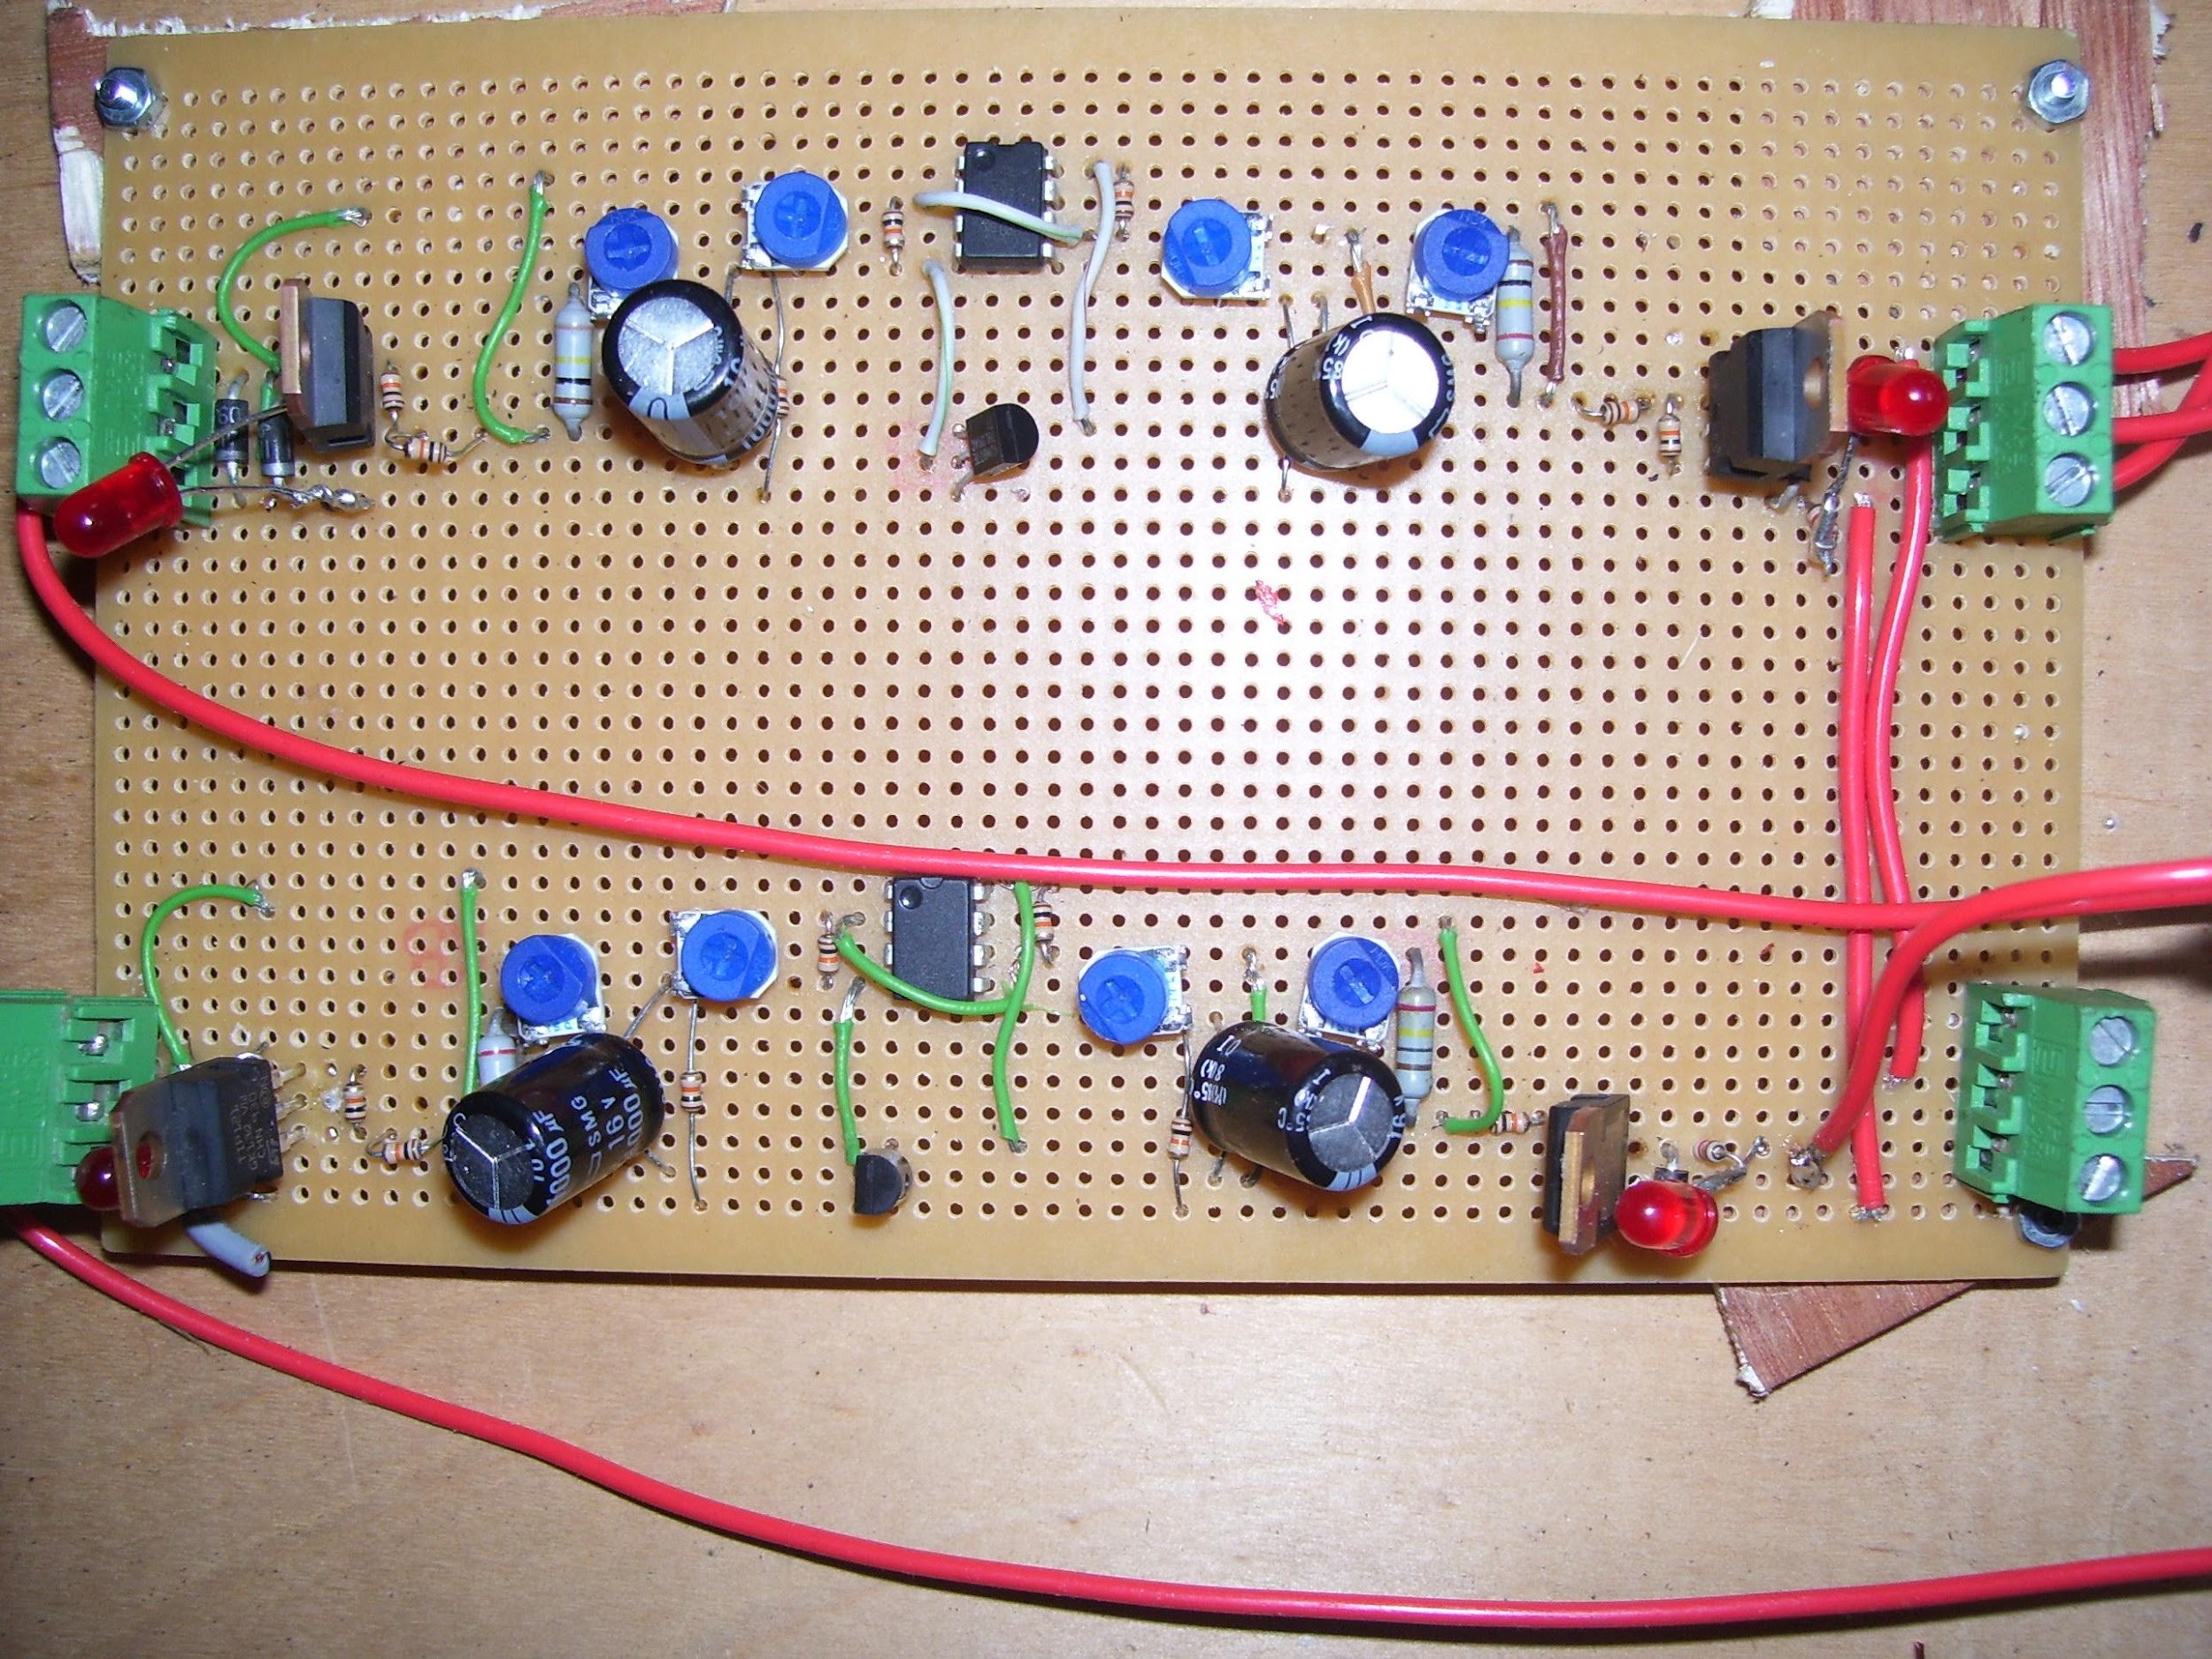
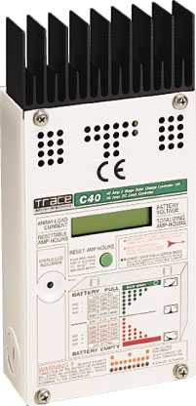
Charge Controller – Buy or Build?
A charge controller with a dump load is an essential part of the system
You can build your own
Or you can buy one

Slide 15
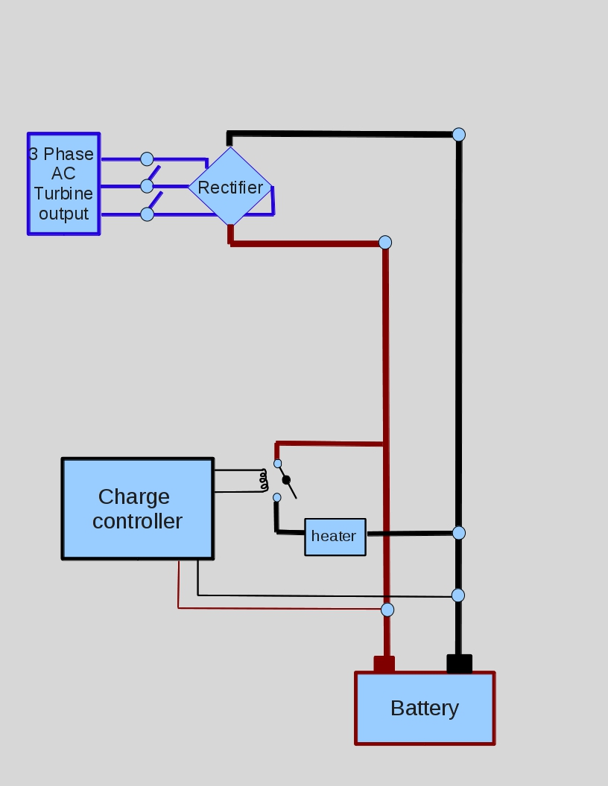
Alternators

Slide 16
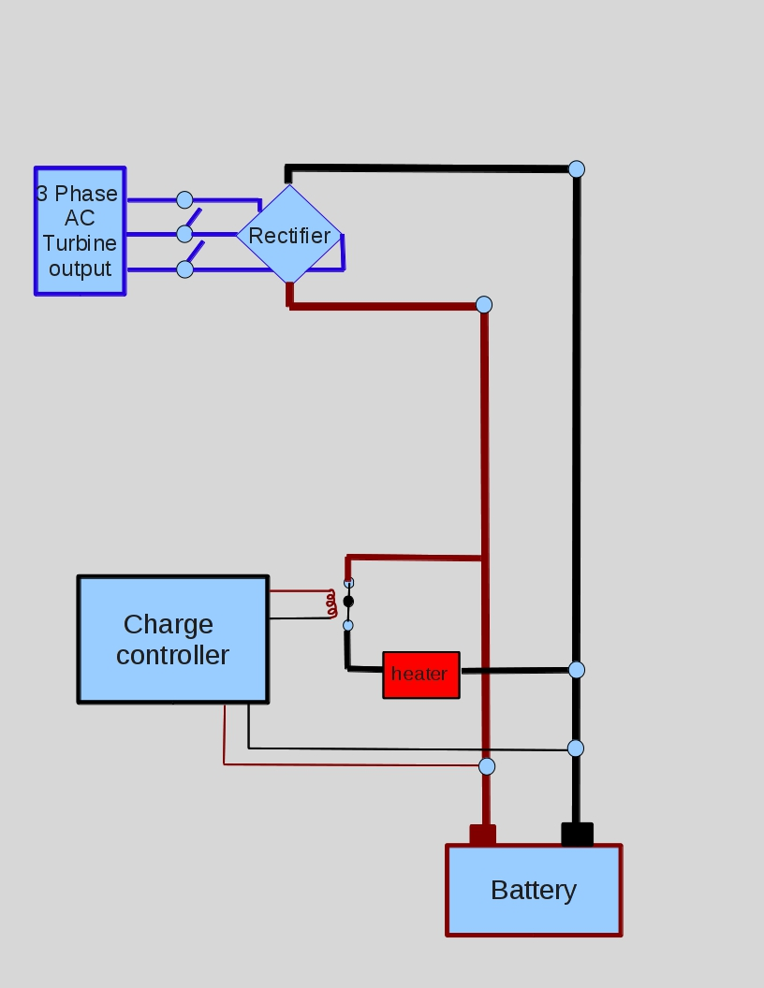
Alternators

Slide 17
Alternators

Slide 18
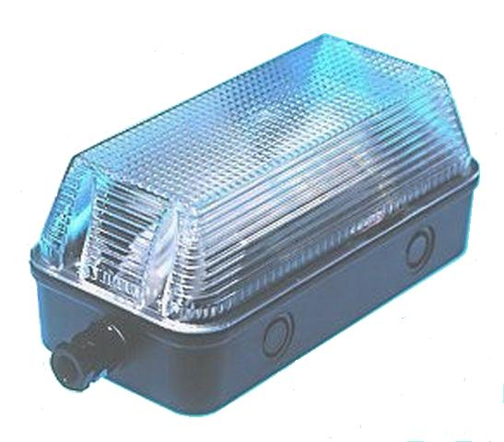
DC Loads
DC loads are run directly from the battery.

Slide 19
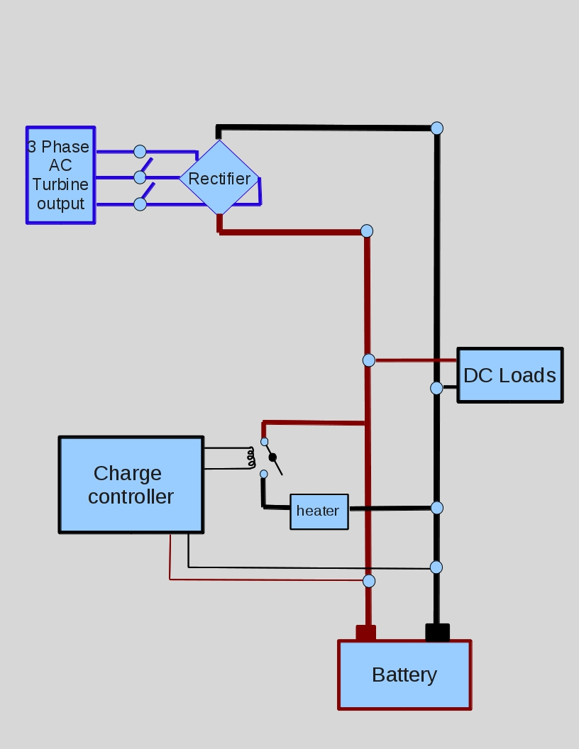
Alternators

Slide 20
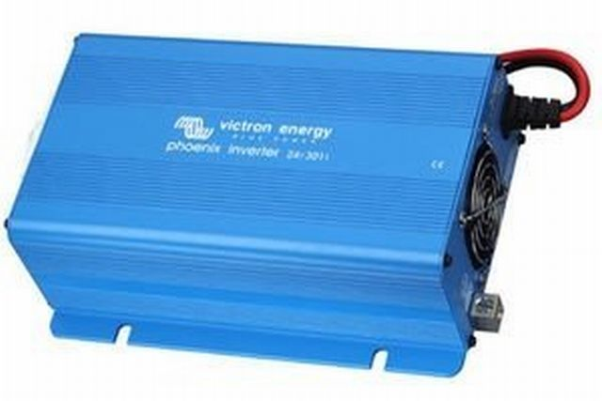
Inverter
To run “mains” appliances you need an inverter

Slide 21
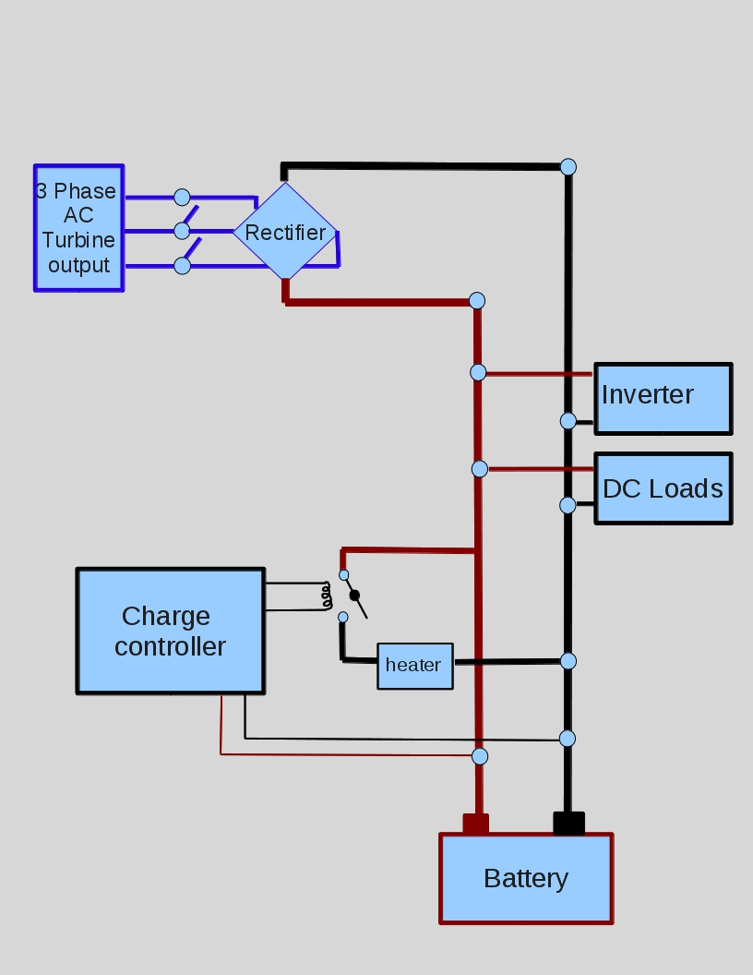
Alternators

Slide 22
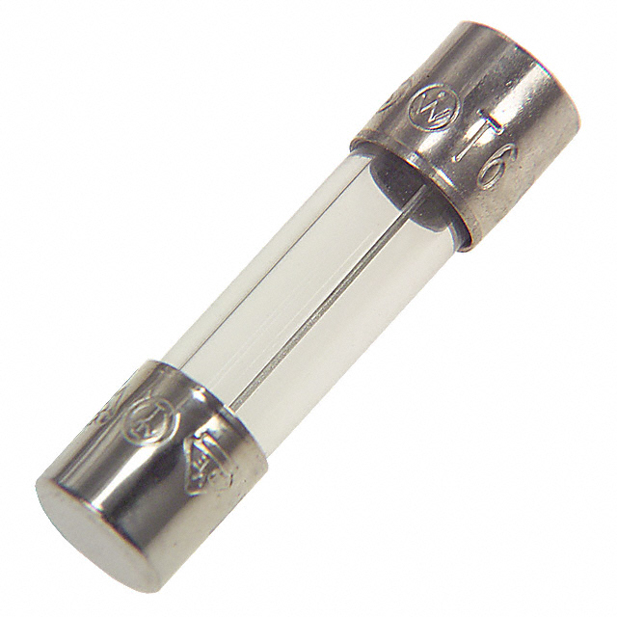
Fuses

Slide 23
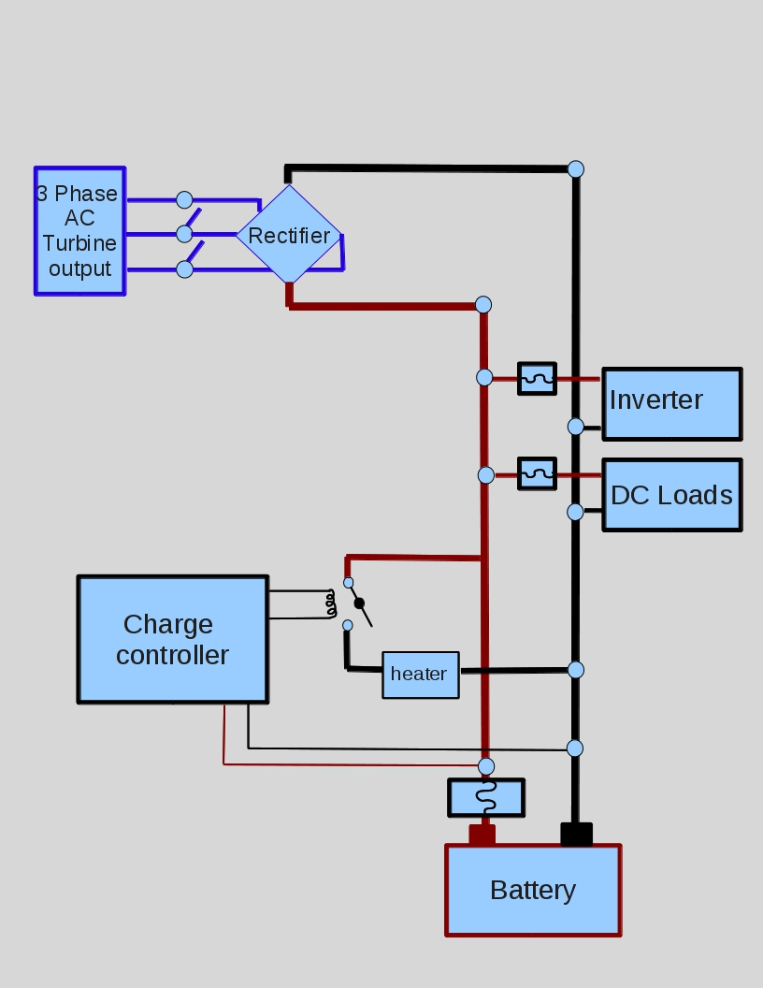
Alternators

Slide 24
Siting, Towers and Case Studies V3 Power

Slide 25
Contents
1. Siting a Wind turbine
2. Towers
3. Wendsor Farm
4. Case Studies
3. Wind Empowerment
4. Useful Links

Slide 26
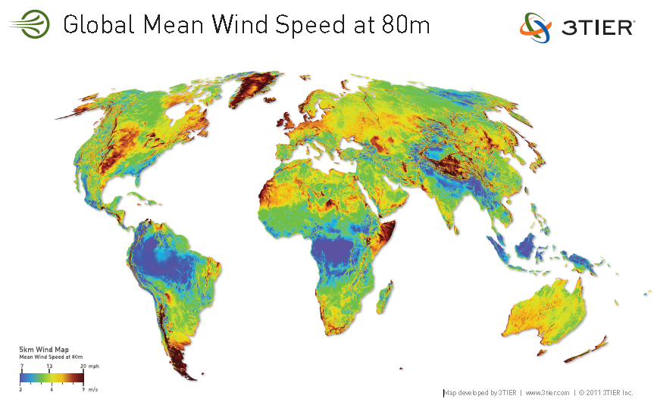

Slide 27
Annual Mean Wind Speed
Notes:
Spot measurements are of little use.
For meaningful data, need to monitor for at least 6 months.
Way it works, has like a tape measure inside which spins out as anemometer turns. At end of year, measure how much tape has been reeled out and divide by time in year to get average wind speed.
The first anemometers did not give an instantaneous reading of wind speed instead they measured the wind run in kilometres or miles. The advantage of this over an instantaneous reading is that it averages out the speed over a period of time. It is this average that we are most interested in.Wind speeds vary very rapidly on a second by second basis. One disadvantage of this type of anemometer is that it does not respond well to rapid variations in wind speed due to its relatively high mass.

Slide 28
Wind over Ridges and Hills
Notes:
Note also that the turbulence begins before the house.

Slide 29
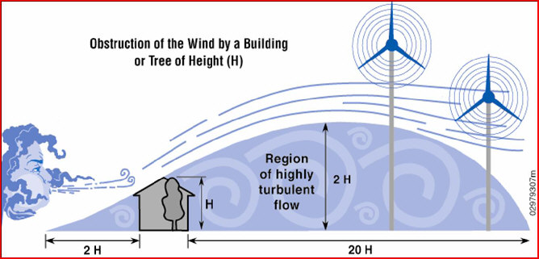
Area of turbulence
Notes:
Note also that the turbulence begins before the house.

Slide 30
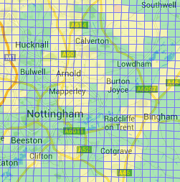
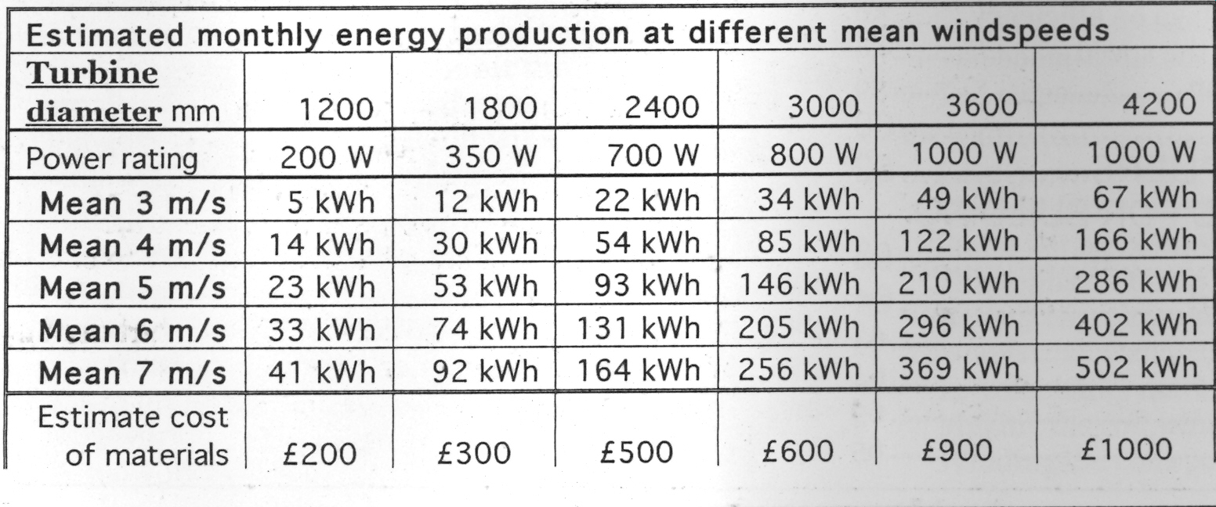
Wendsor Farm
http://www.rensmart.com/Weather/BERR
Height above Ground Level | Annual Wind Speed
10m | 4.8m/s
25m | 5.5m/s
45m | 6.1m/s
Notes:
Note also that the turbulence begins before the house.

Slide 31
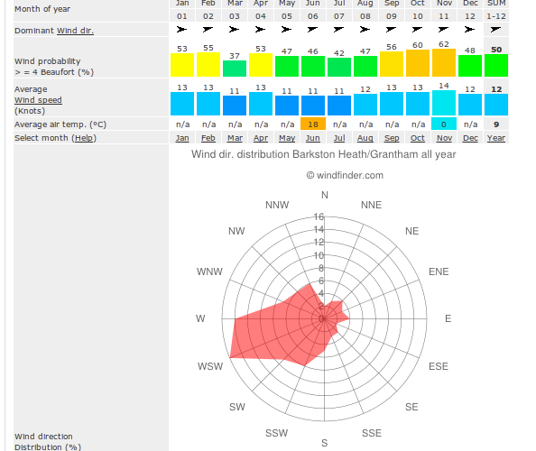

Slide 32
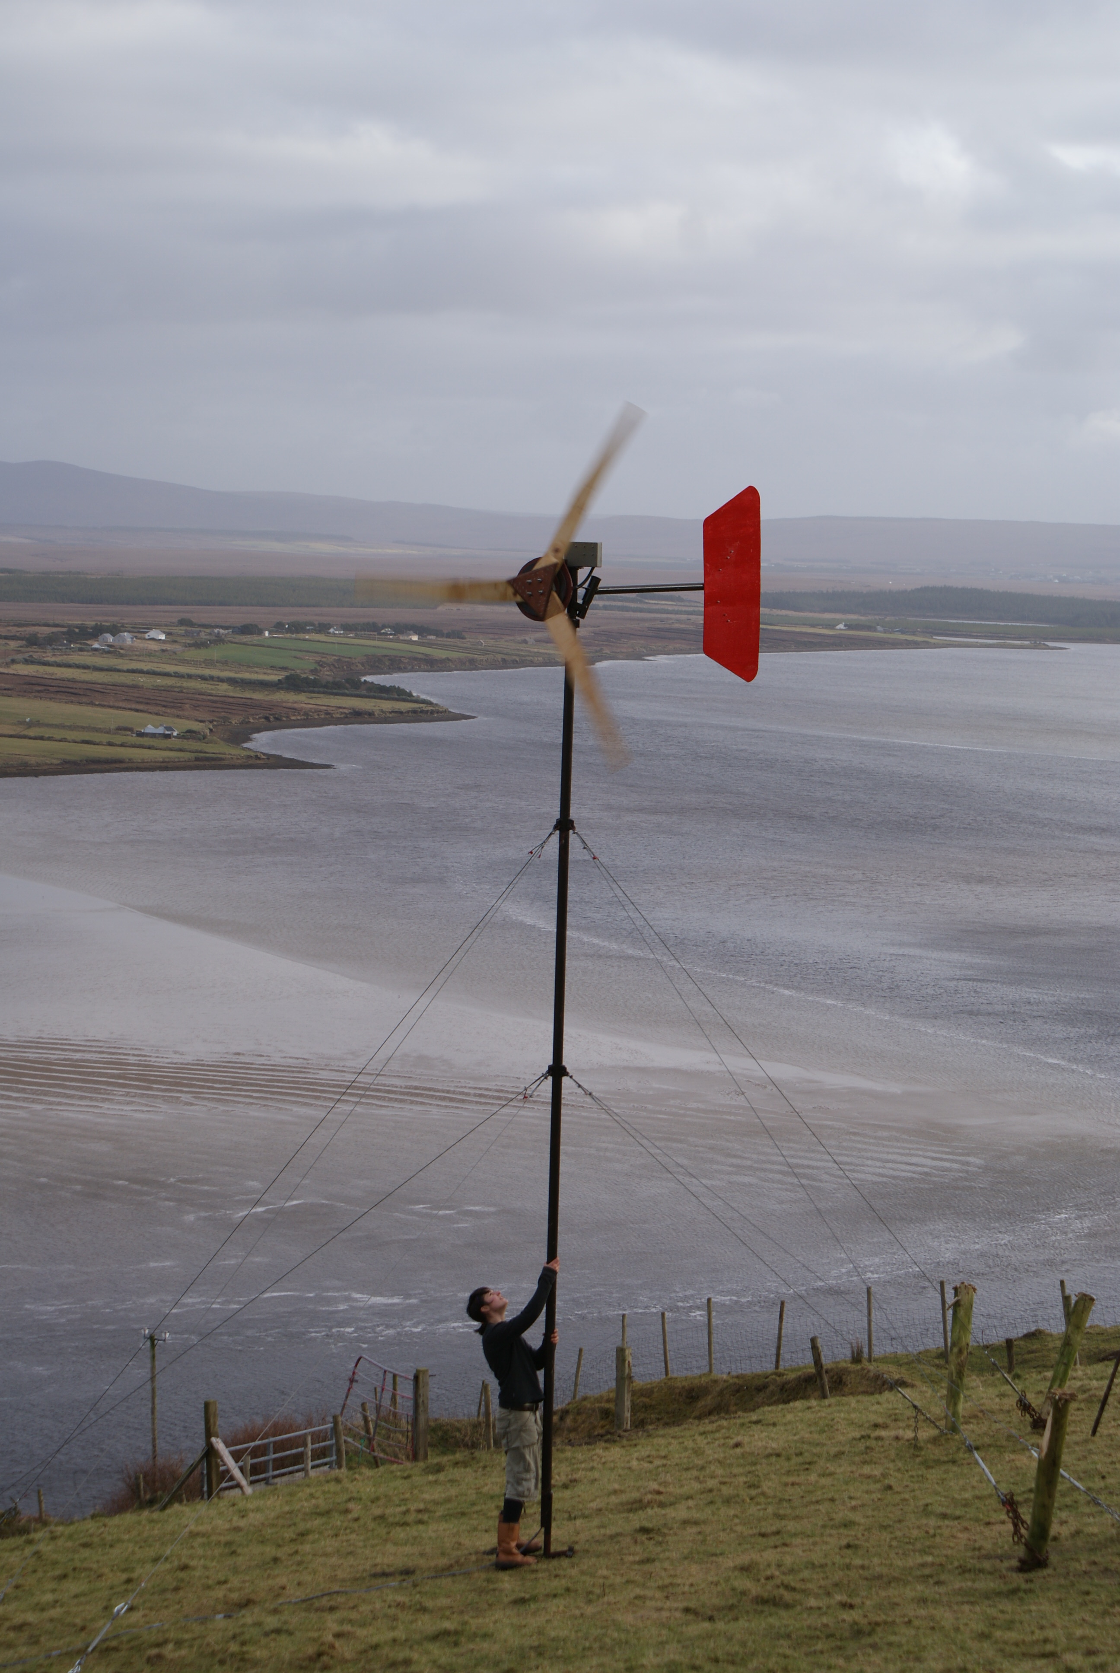
Tower Designs
Guyed Tower
45
45

Slide 36
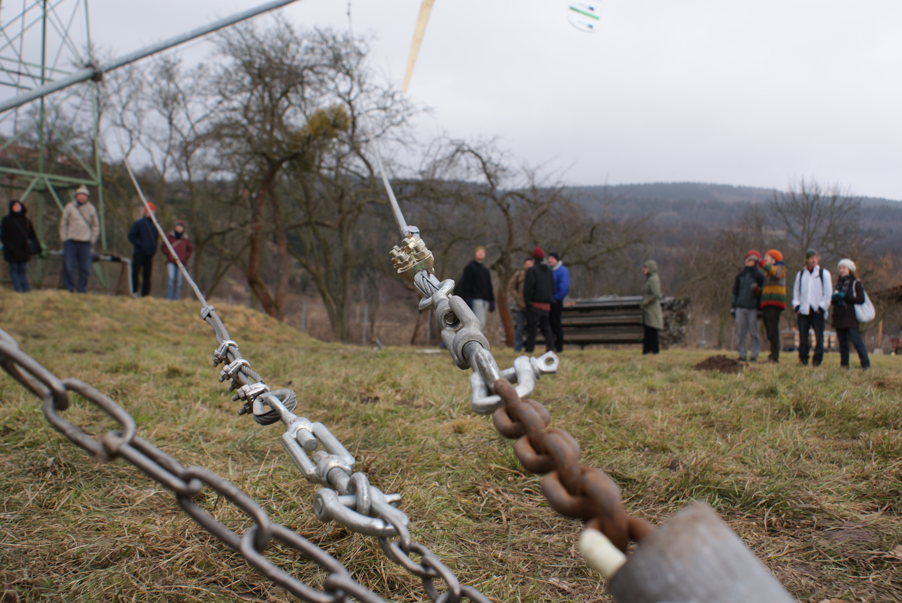
Turbine Maintenance

Slide 37
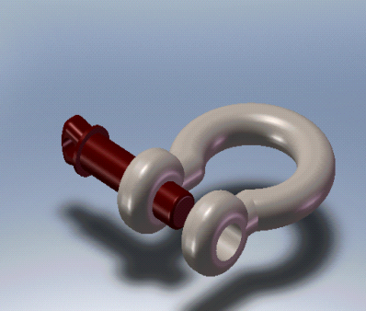
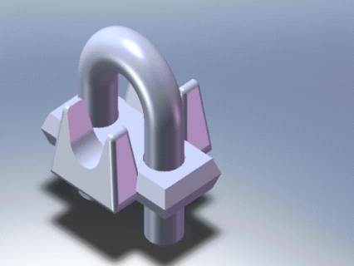
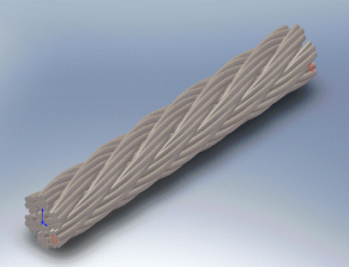
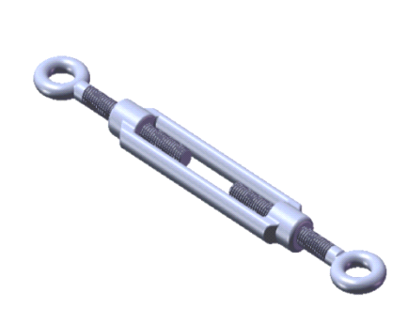
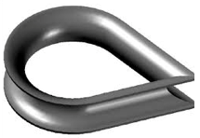
Shackle
Wire Rope
Cable Clamp
Shackle
Thimble
Turnbuckle

Slide 38
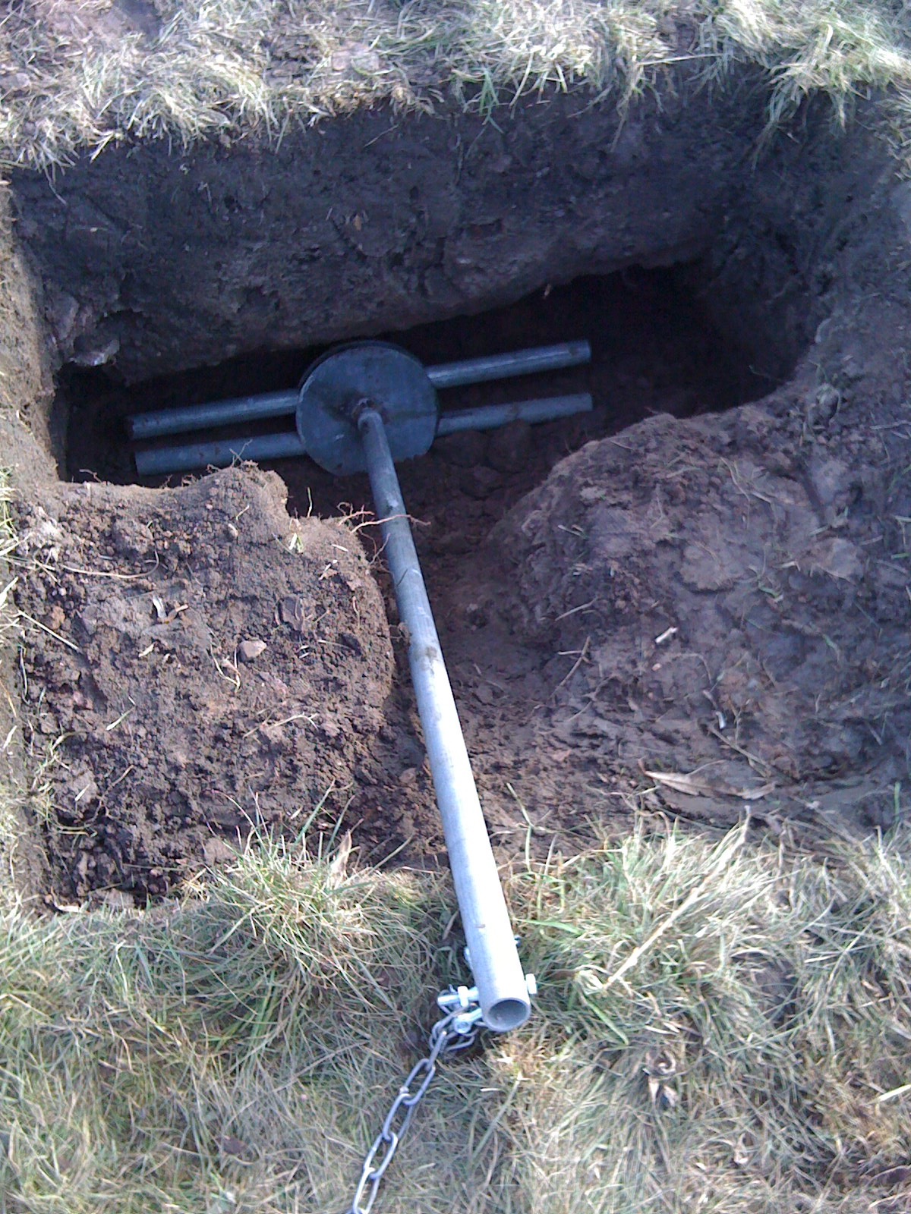
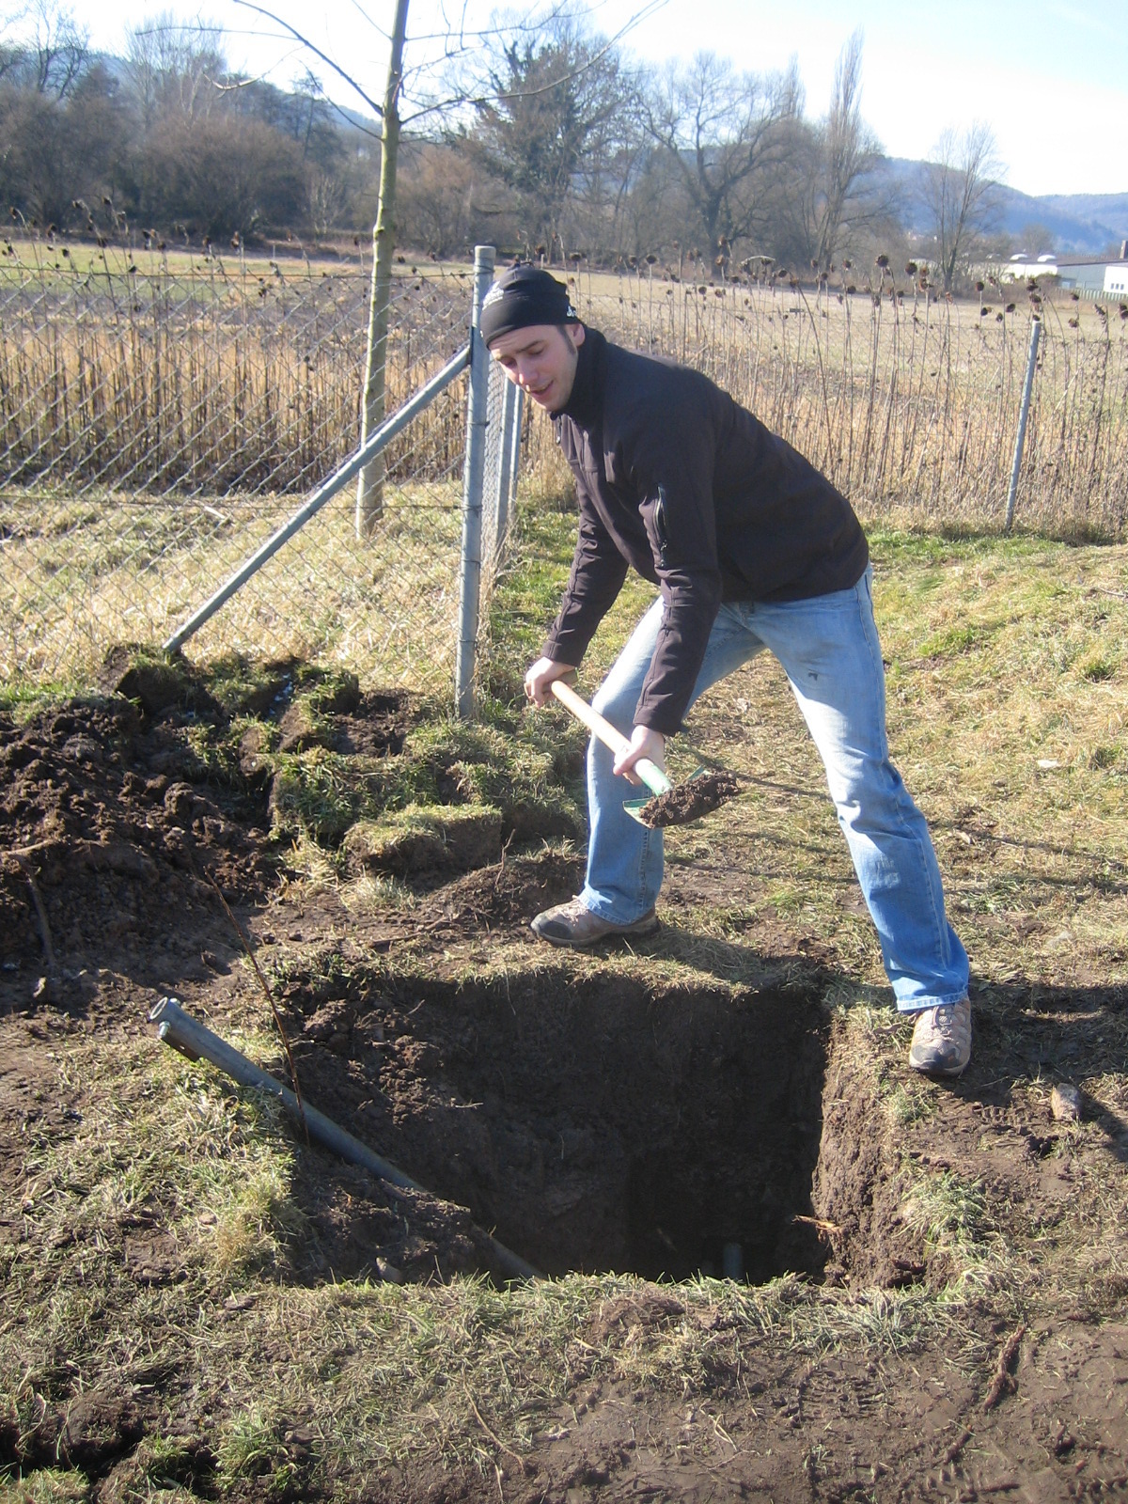
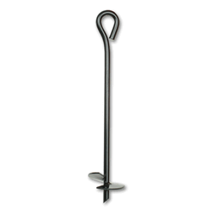
Anchors

Slide 39
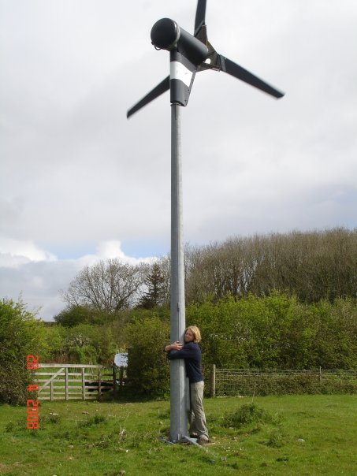
Free standing

Slide 40
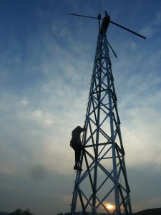
Lattice Tower

Slide 41
52m Lattice Tower with Crane (USA)

Slide 42
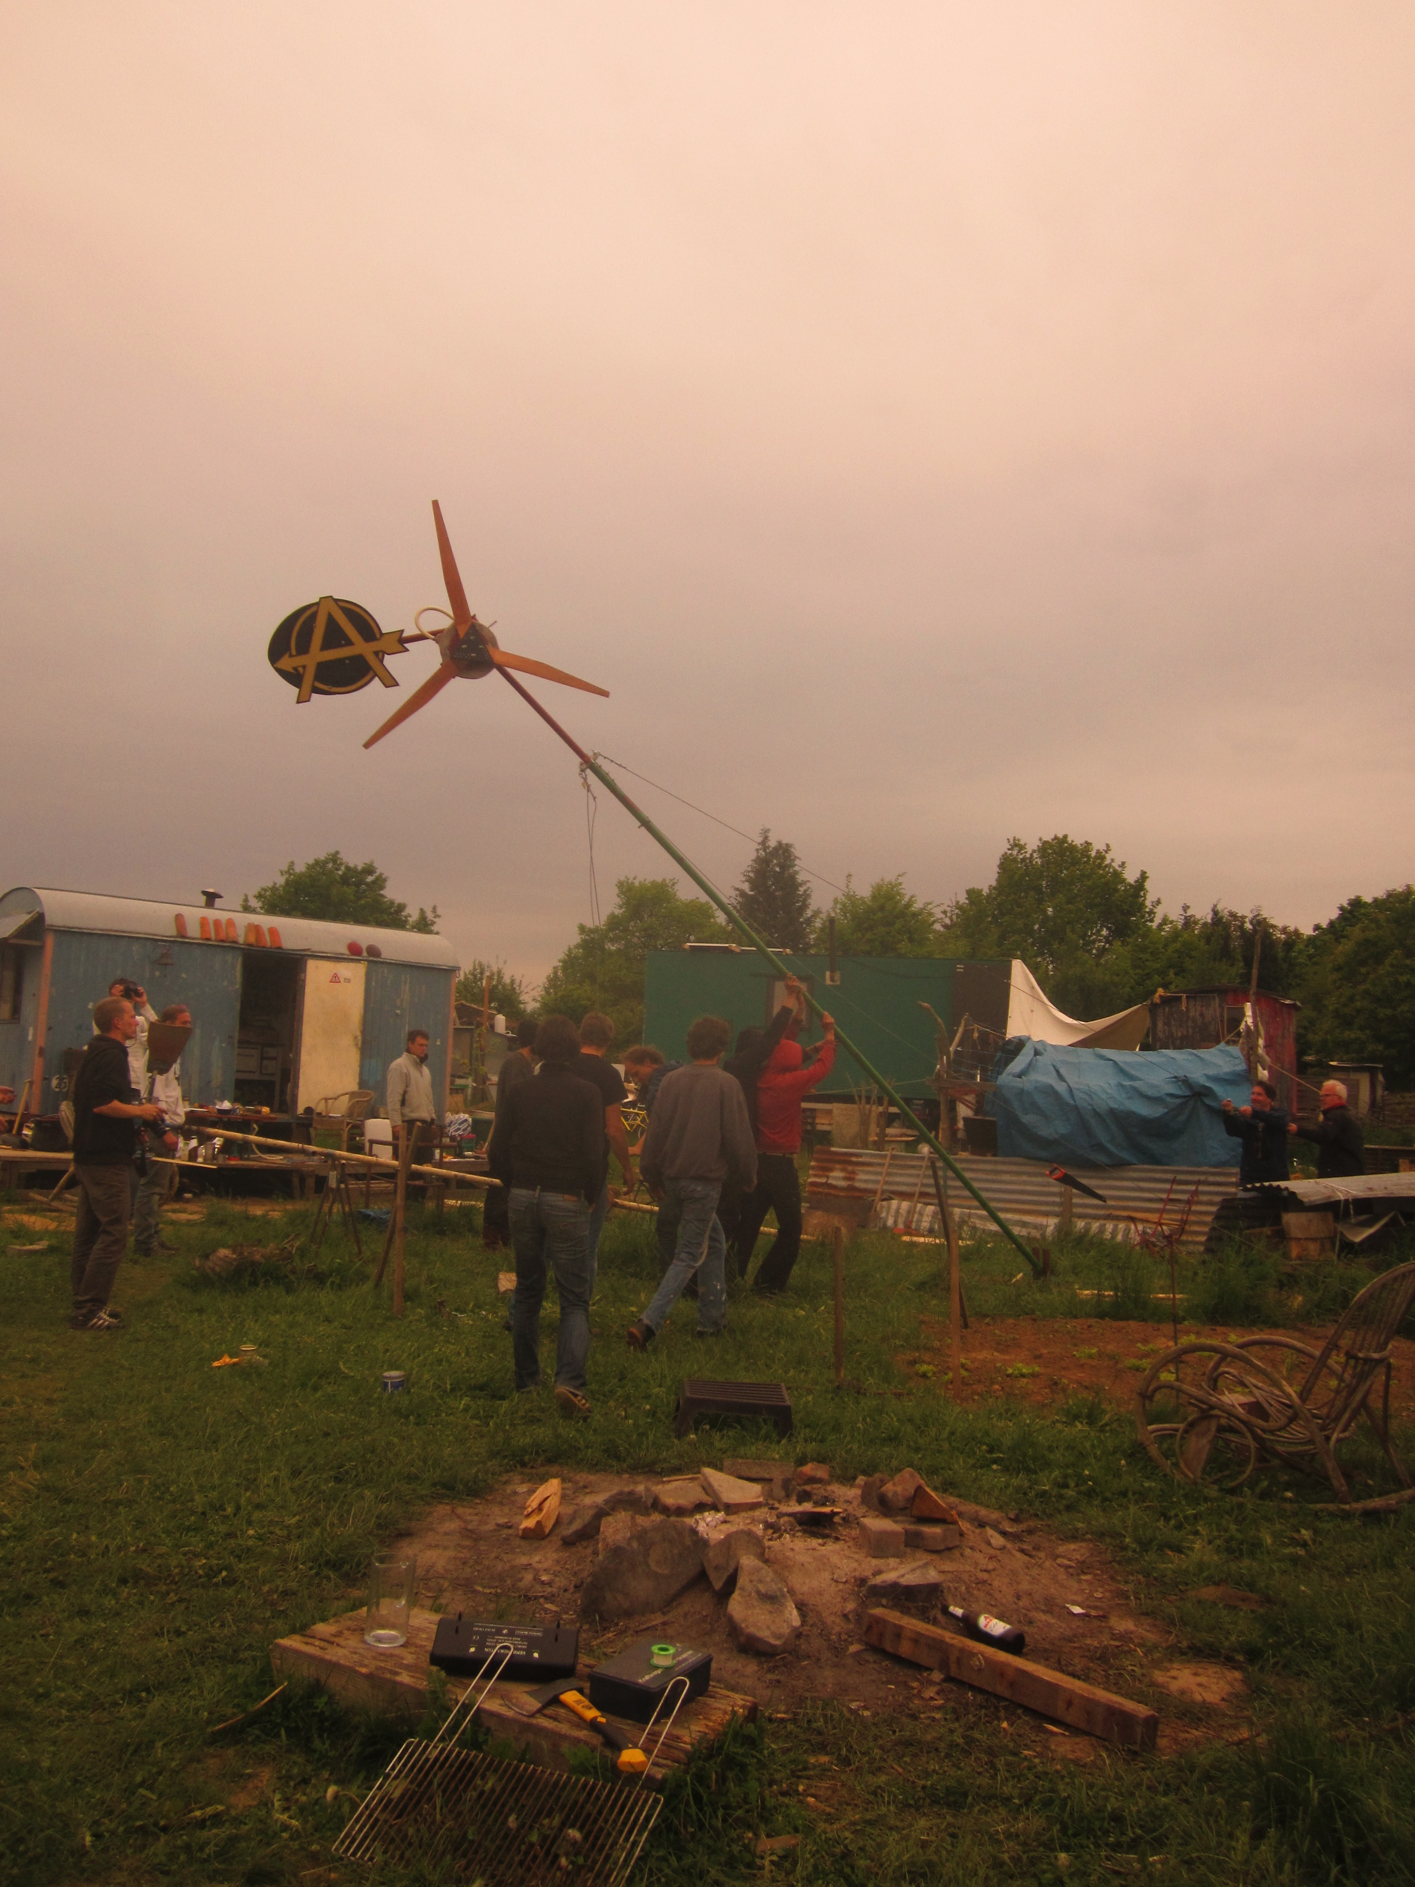
Wagonplatz, Germany
Off Grid Domestic Power System
- 1.8m Turbine
- 12V Battery System
- 300W Inverter
- Variety of Small PV
- Central battery
storage in kitchen
- Smaller systems in
each wagon fed by PV
- Lighting, Laptops

Slide 43
Wind Empowerment
International association of Hugh Piggott Wind Turbine Builders
Information sharing
Research – Technical and Social

Slide 44
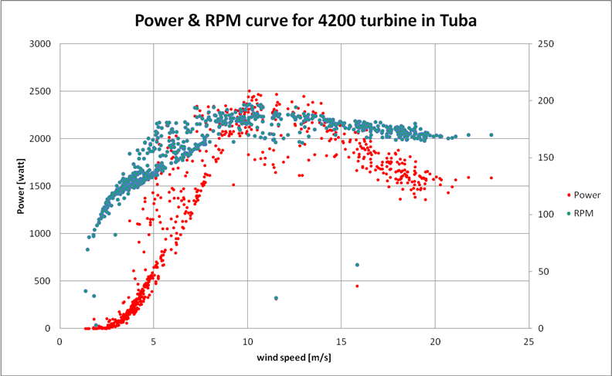
Wind Empowerment - Research
Technical and Social:
- Rotor and alternator efficiency
- Levelised Cost of Energy
- Social Integration of Turbines

Slide 45
Links
Fieldlines – discussion forums
Www.fieldlines.com
The Back Shed
Www.thebackshed.com
Hugh Piggott's Website
Www.scoraigwind.co.uk
Wind Empowerment
Www.windempowerment.com
V3 Power
Www.v3power.co.uk

