Slide 1
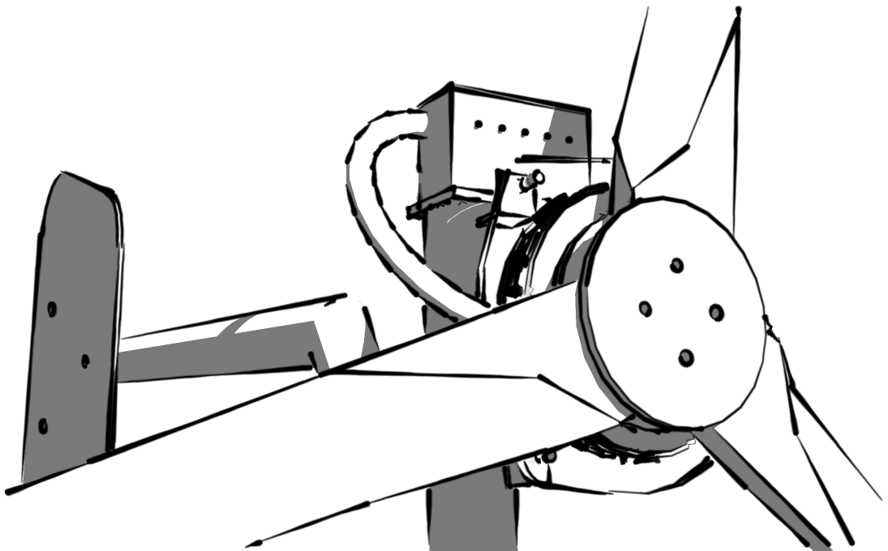
Wind Turbine Workshop V3 Power

Slide 2
Contents
Introductions
V3 Power
The Hugh Piggott Turbine
Blade theory
Alternator theory

Slide 3
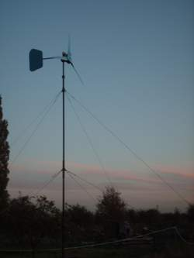
V3 Power
DIY Renewable Energy Cooperative
DIY
Small scale, focus on education
Renewable Energy
Mainly wind turbines
Cooperative
We are our own bosses
Est 2006
Around 20 trained instructors
This is our 76th wind turbine course

Slide 4
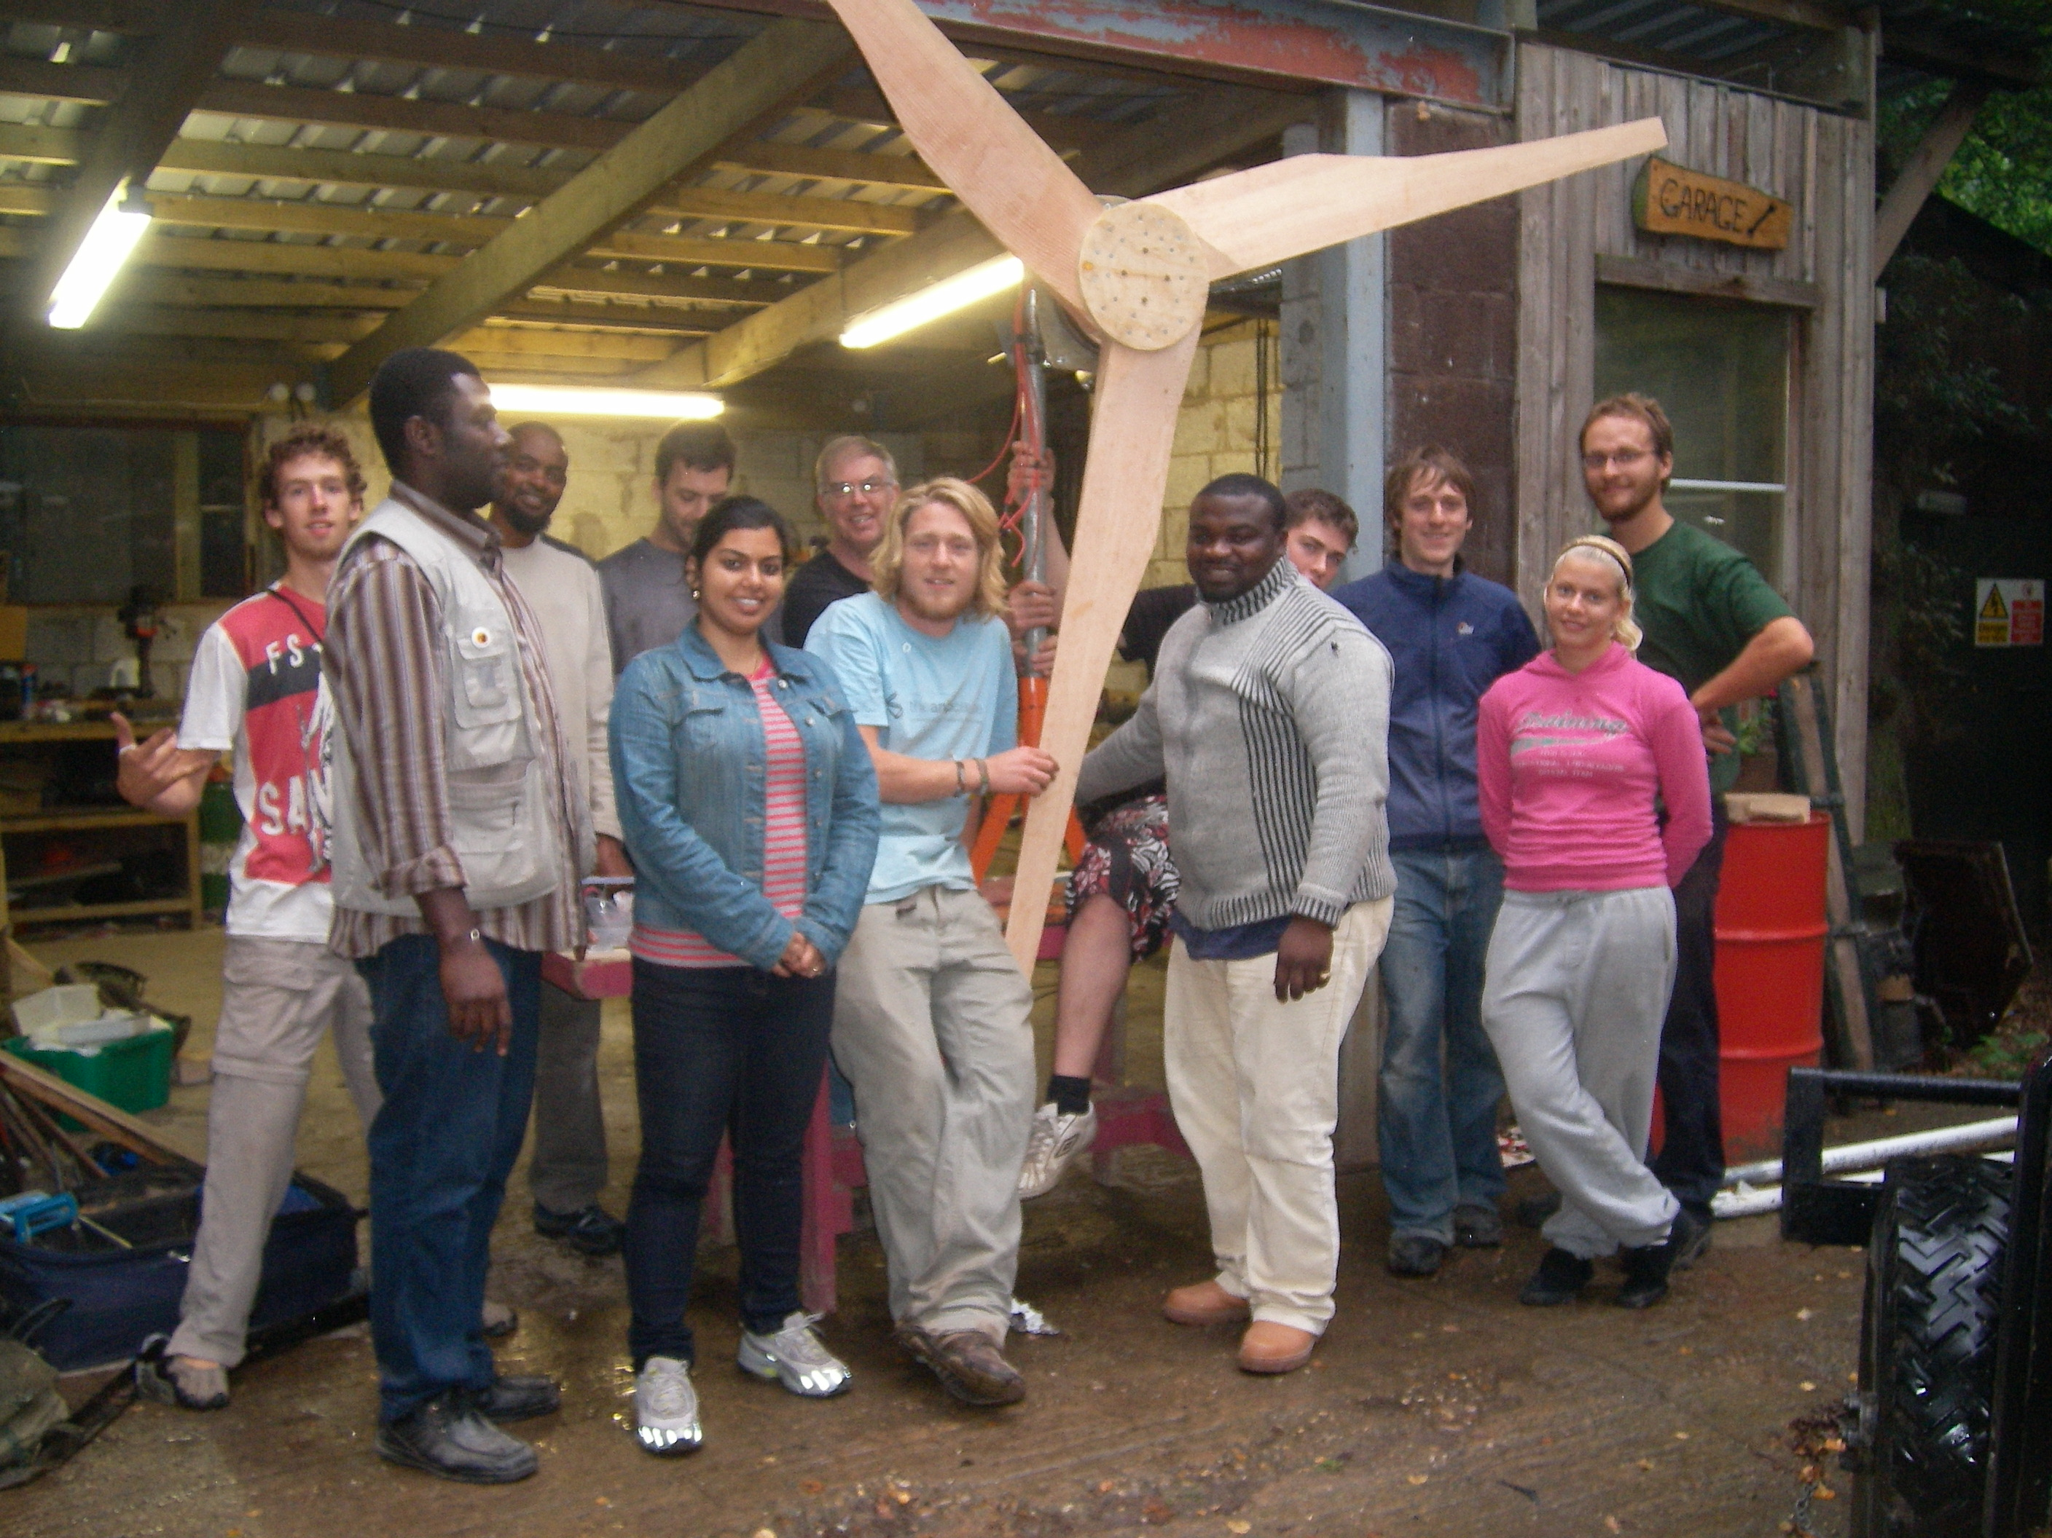
What V3 does
Courses:
Wind Turbines
Solar Water Heating
Pedal Generation
Biomass stoves
Installations
Farms, Allotments,
Off-Grid Systems,
Universities
Workshops/Demonstrations
Festivals, Schools

Slide 5
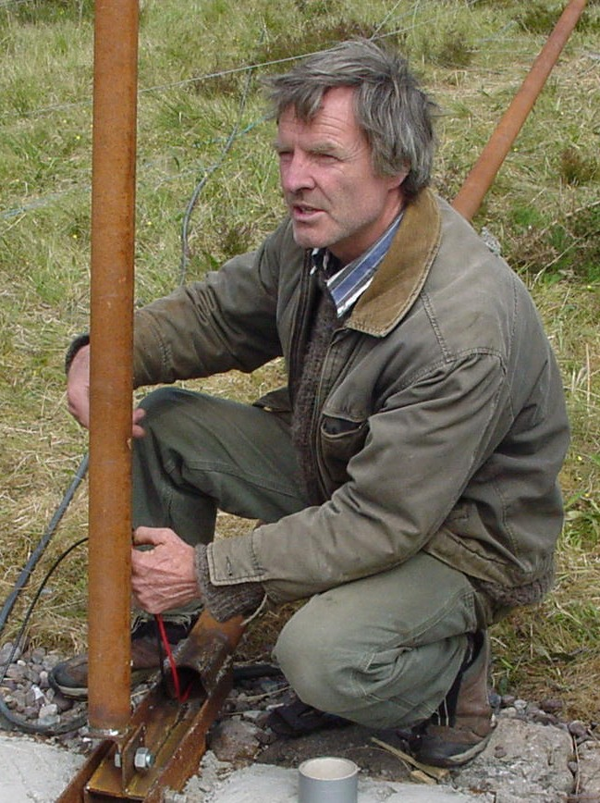
Hugh Piggott
Godfather of small wind
Publishes wind turbine recipe book
Scoraig -off grid community
24/7 support
www.scoraigwind.co.uk

Slide 6
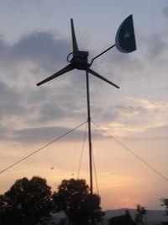
The Hugh Piggott Turbine
Robust
Ease of manufacture (axial-flux)
Materials available locally
Low Embodied Energy
Hand tools
Reclaimed materials

Slide 7
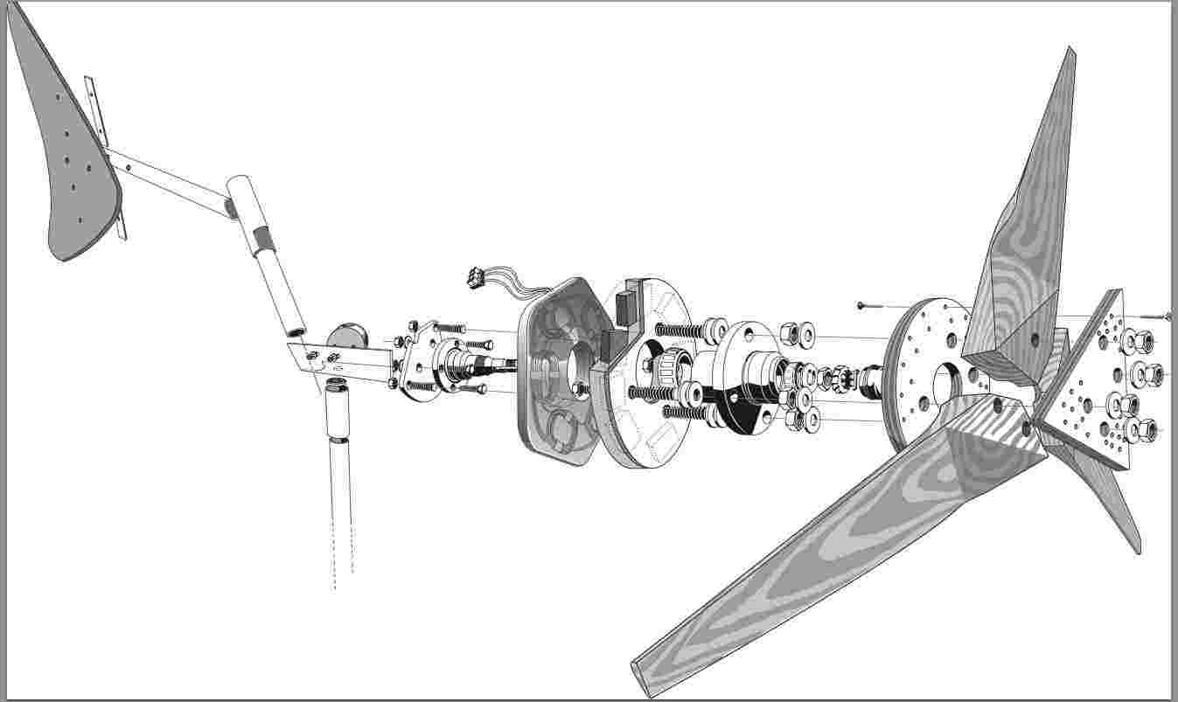
Modular

Slide 8
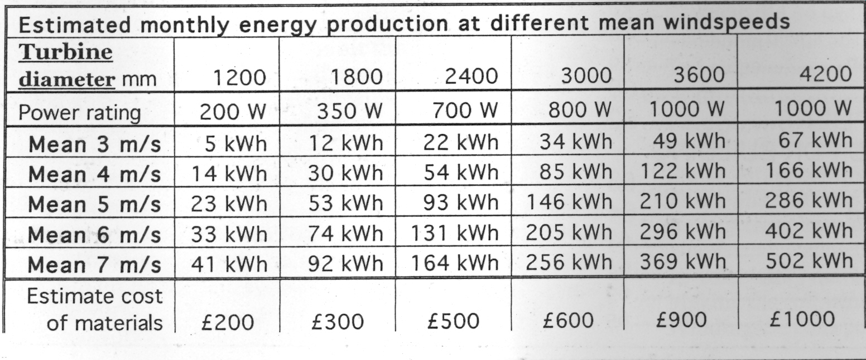

Slide 9
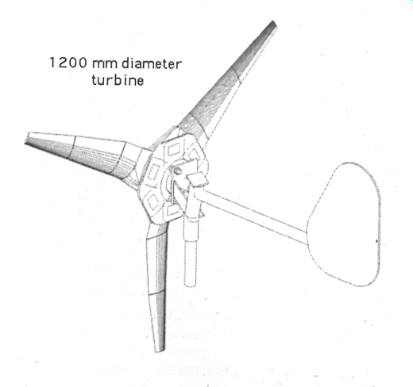
This course
This course we'll be building a Hugh Piggott turbine:
Blade Diameter: 1.2m, Pine blades
Rated Power: 200W @ 11.5m/s
Stator Voltage: 24V
6 coils, 8 magnets

Slide 10
Blade Design

Slide 11
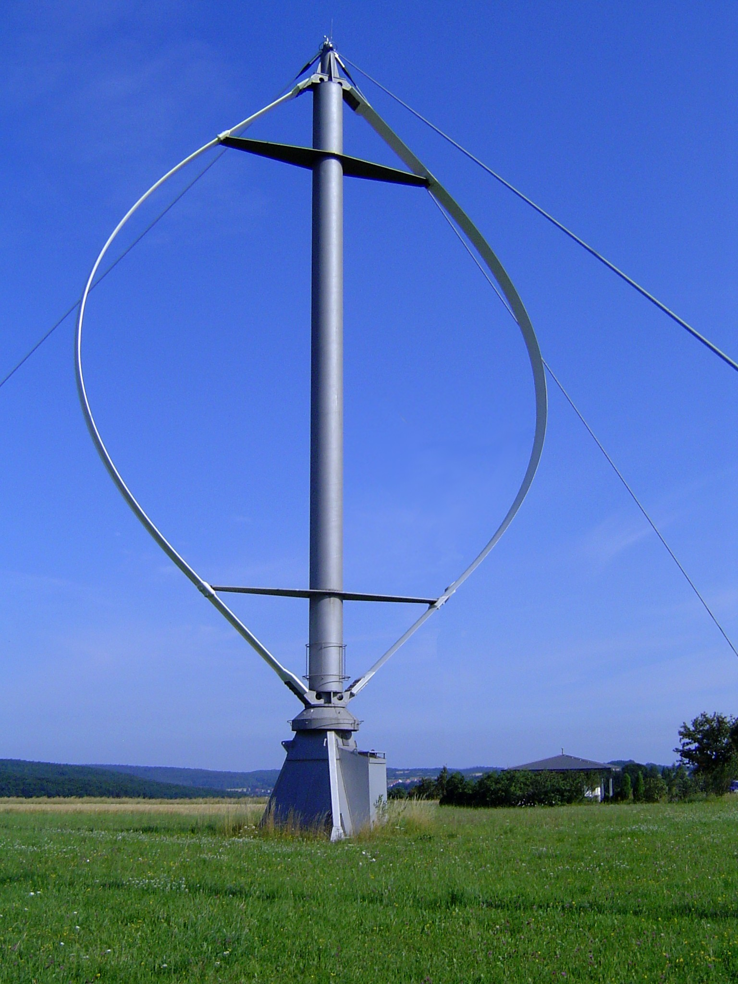
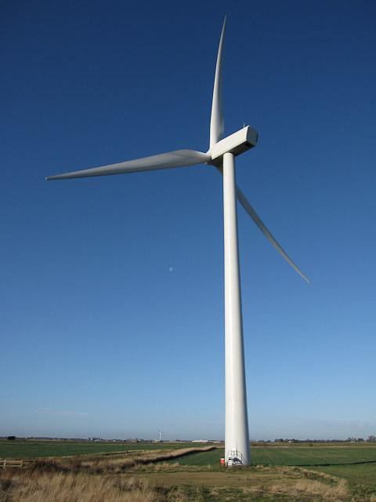
Which Axis?
Vertical
Horizontal

Slide 12
Forces
DRAG
Blade Movement
Reflected Wind
Wind

Slide 13
Forces
Head Wind
Apparent Wind
Actual Wind

Slide 14
Forces
High speed flow
Low speed flow
Apparent Wind

Slide 15
Forces
High speed flow
→ low pressure
Blade Motion
Lift
Low speed flow
→ High pressure

Slide 16
Twist
C1
C2
Velocity at C1 > Velocity at C2

Slide 17
Forces
Lift
Head Wind
Head Wind
Apparent Wind
Apparent Wind
Actual Wind

Slide 18
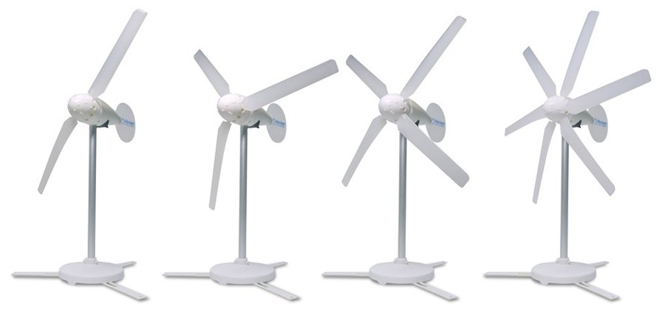
How Many Blades?

Slide 19
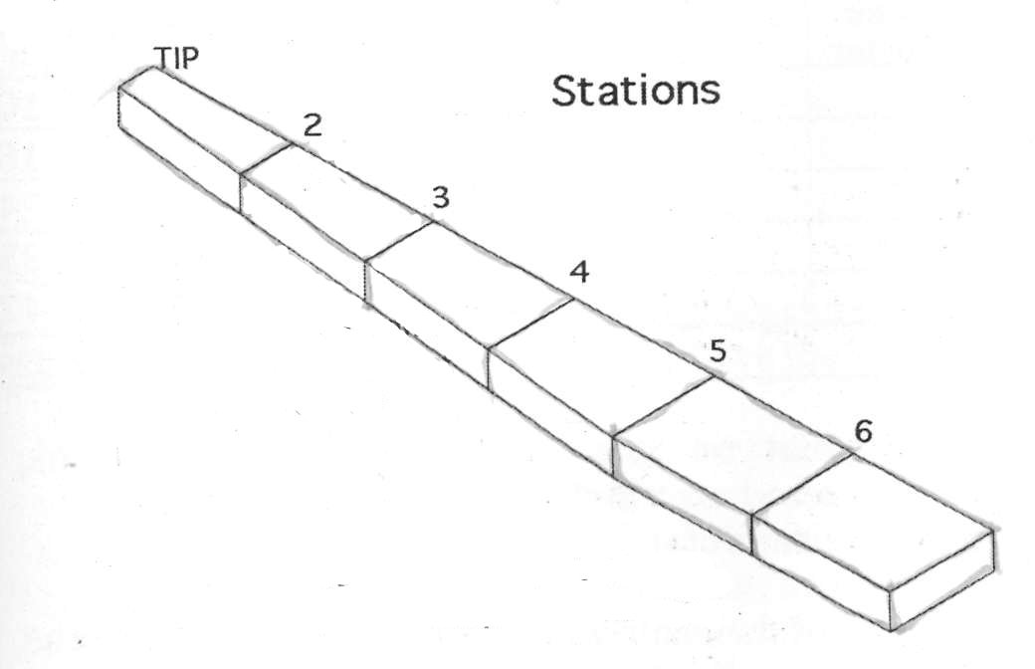
Hugh Piggott Blade Design
Blades
Hugh Piggott – Wind Turbine Recipe Book

Slide 20
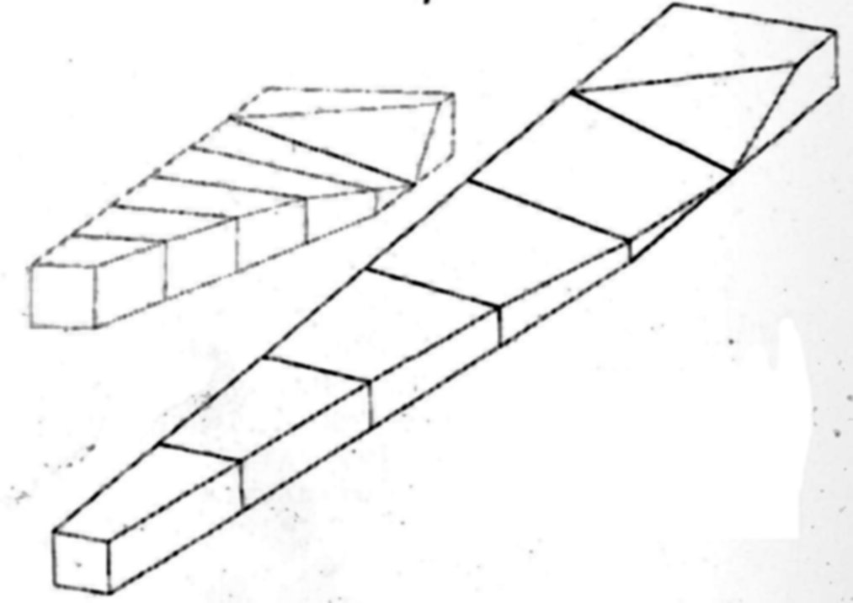
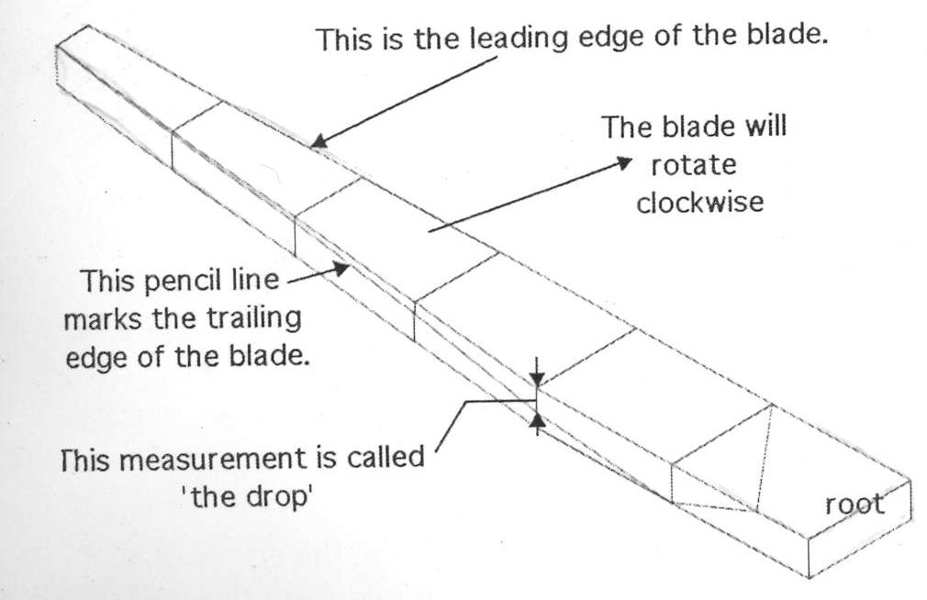
Blade Carving - The Drop
Blades
Hugh Piggott – Wind Turbine Recipe Book
Hugh's design is a trade-off between efficiency and ease of manufacture
To carve a blade from a straight plank of wood we must first cut it into a tapering shape – this is to reduce the drag force where it is spinning fastest

Slide 21
Blade Carving – Airfoils
Blades
The front face of the blade is now finished – the next job is to carve the rear face of the blade to the right thickness
We mark the thickness of the blade at each station and then join the dots again – the blade is uniformly thick at each station and tapers towards the root
This is another trade-off – the blade should be as thin as possible all the way along to reduce drag, but because the root of the blade needs to be stronger it also needs to be thicker

Slide 22
The Alternator V3 Power

Slide 23
Contents
Faradays law
Voltage of a coil
Arrangement of magnets
Wiring of phases

Slide 24
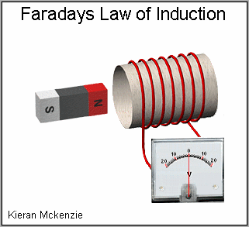
Faradays Law
“The induced electromotive force in any closed circuit is equal to
the rate of change of the magnetic flux through the circuit.”

Slide 25
Alternating Current
The current reverses direction as the magnet passes over

Slide 26
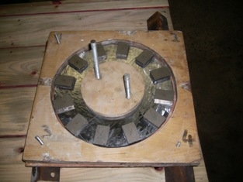
Magnetic Flux
N
S
N
N
S
S
S
N

Slide 27
Phases
Picture: Jesse Salisbury

Slide 28
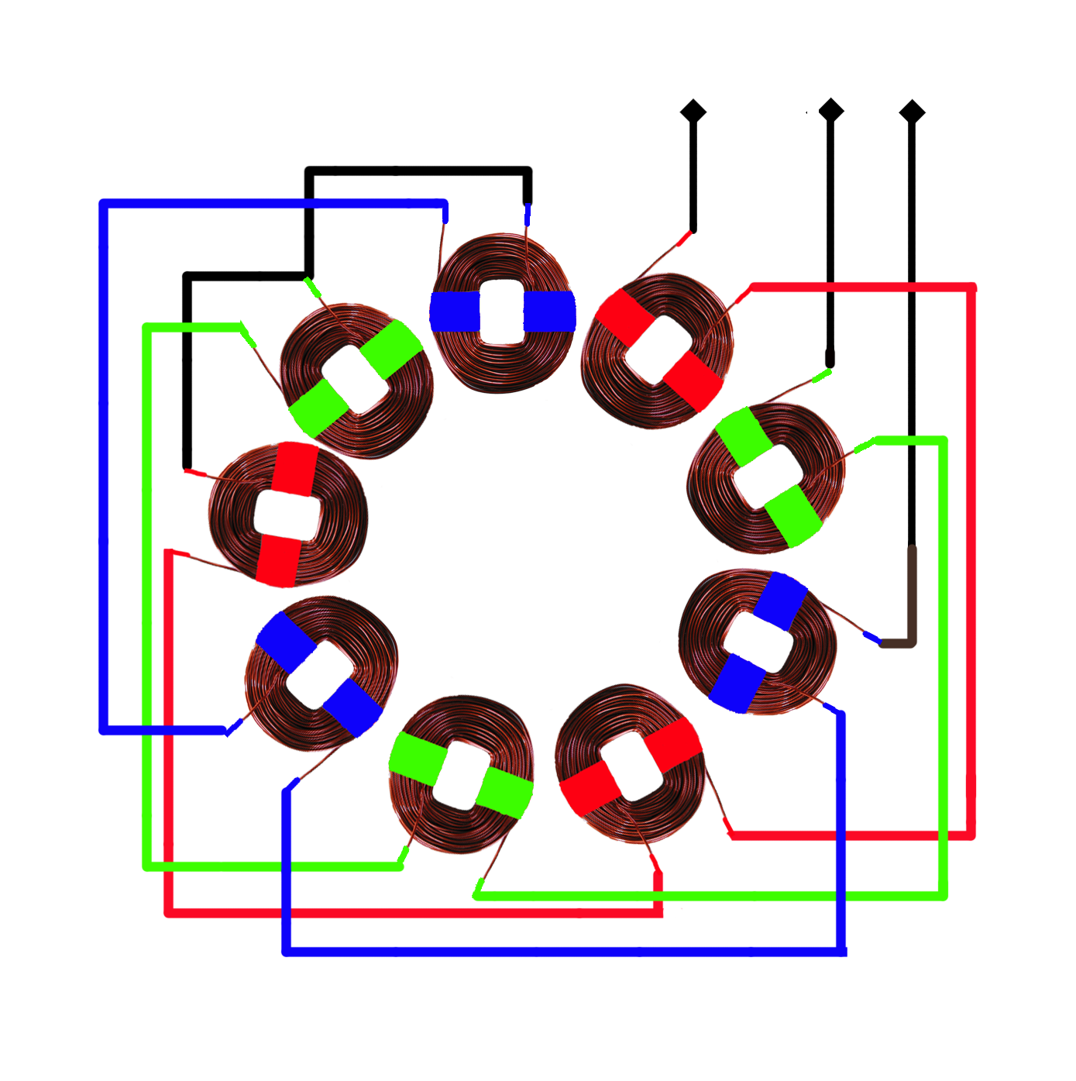
Phases
Picture: Jimmy of Eirbyte

Slide 29
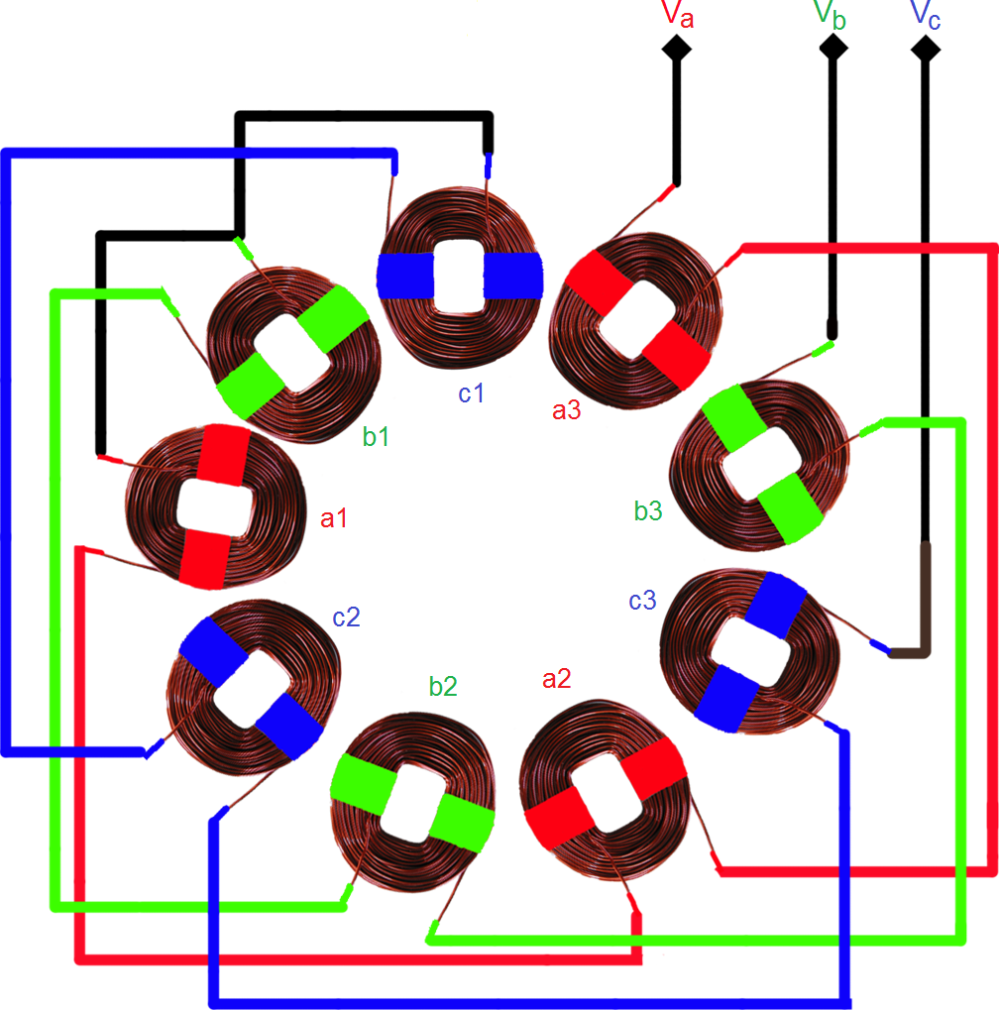
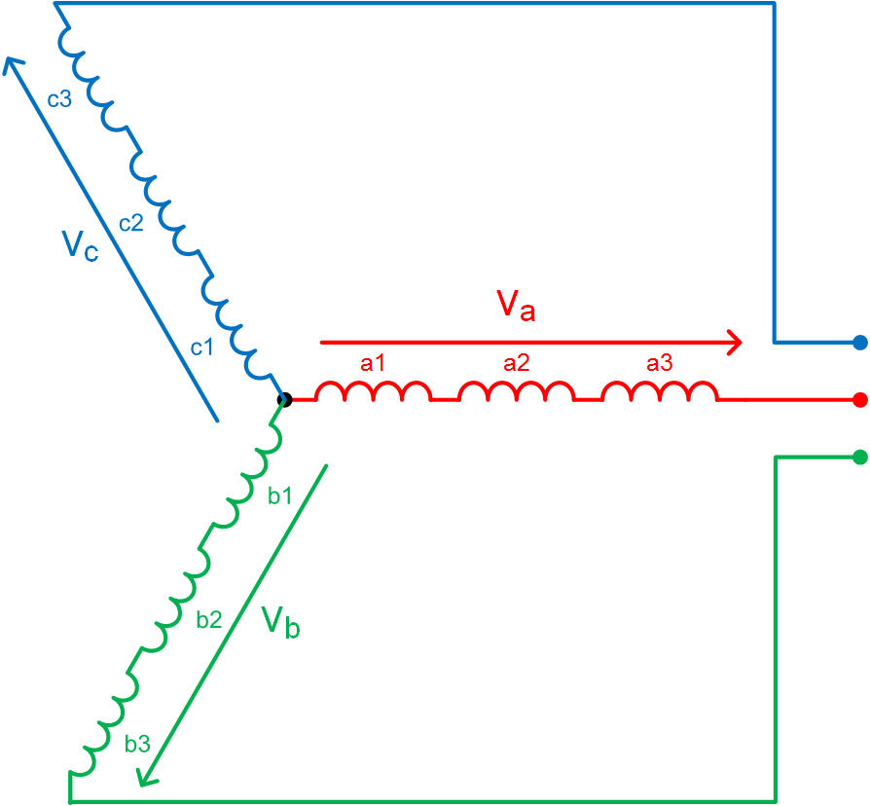
Picture: Jimmy of Eirbyte

Slide 30
Health and Safety
(is no accident)
Hazards:
Blades – Fingers, Eyes, Splinters
Alternator – Nails, Jigsaw, Magnets, Soldering
Precautions:
Be aware of what’s going on around you
Ask if you don’t know
Don’t Rush!

